Slide 1

Westchester Soccer Referees Organization
August 2026 Pre-Season Meeting

Slide 2
WSRO Pre-Season Meeting
Agenda
Law Changes for 2026/27
First Impression
League issues/requests
Questions from Members

Slide 3
WSRO Pre-Season Meeting - Elections
Board Members
  President - Piero Olcese
  2nd VP - Jack Langstine
  Recording Secretary - Frankie McConnell
  Trustee
  Rich Caldropoli
  Lara O'Callaghan
  Andrew Kinal

Slide 4

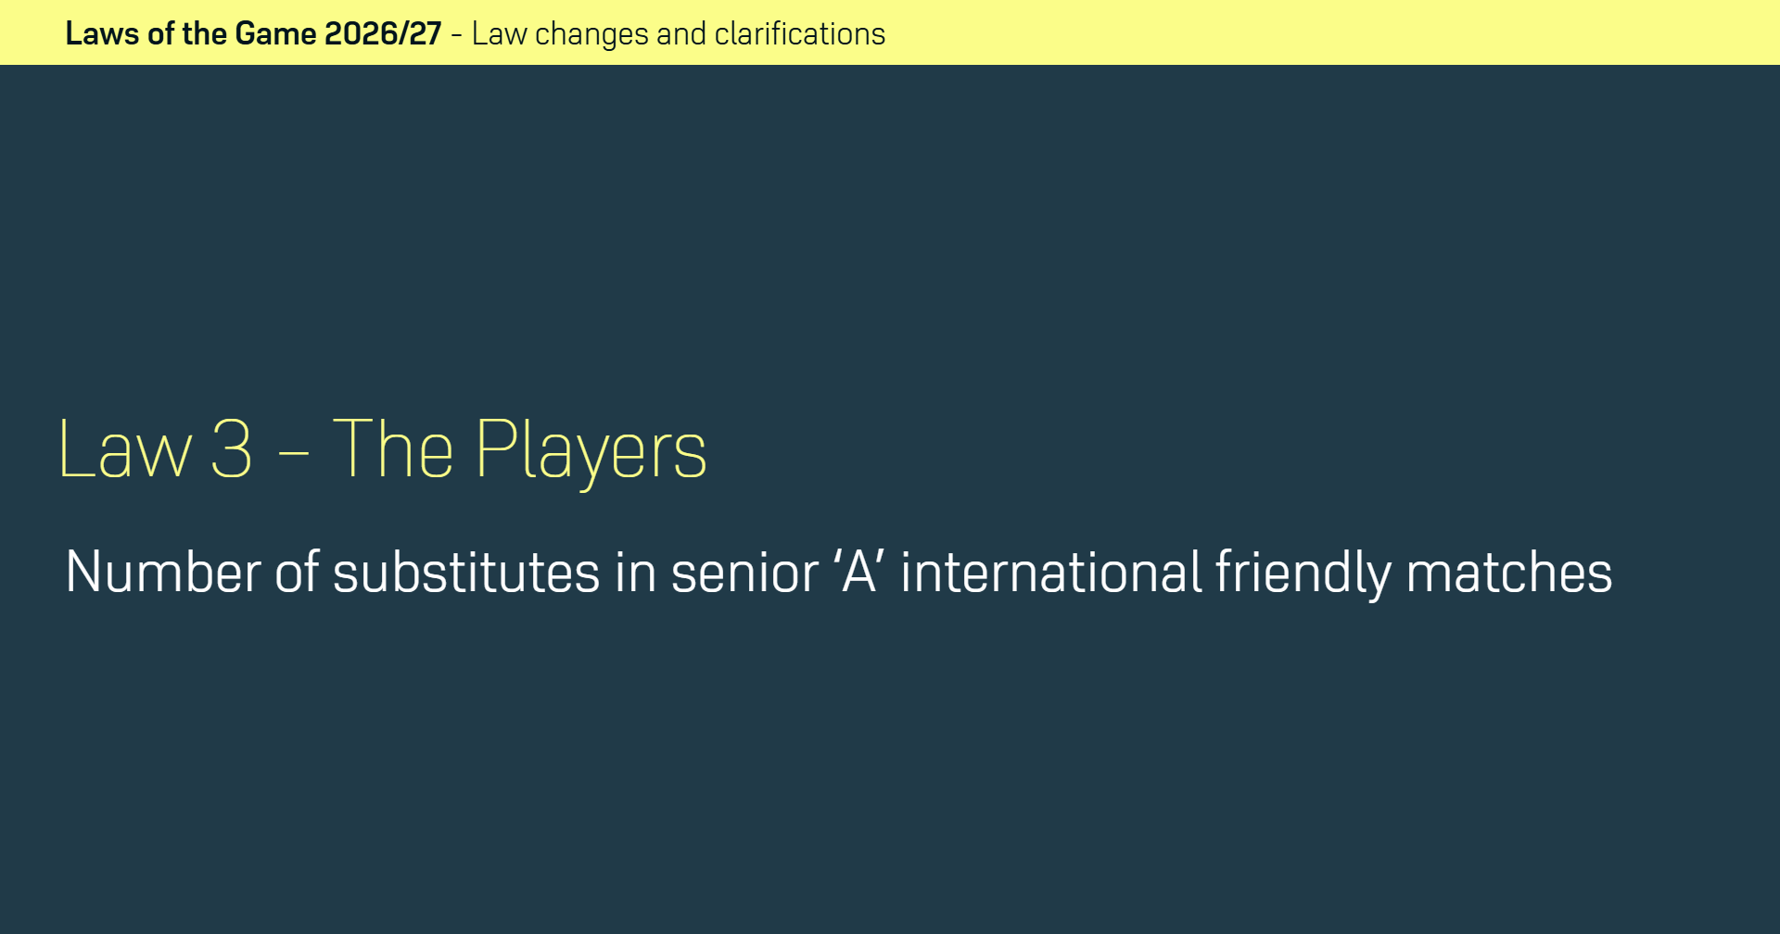

Law Changes

Slide 5
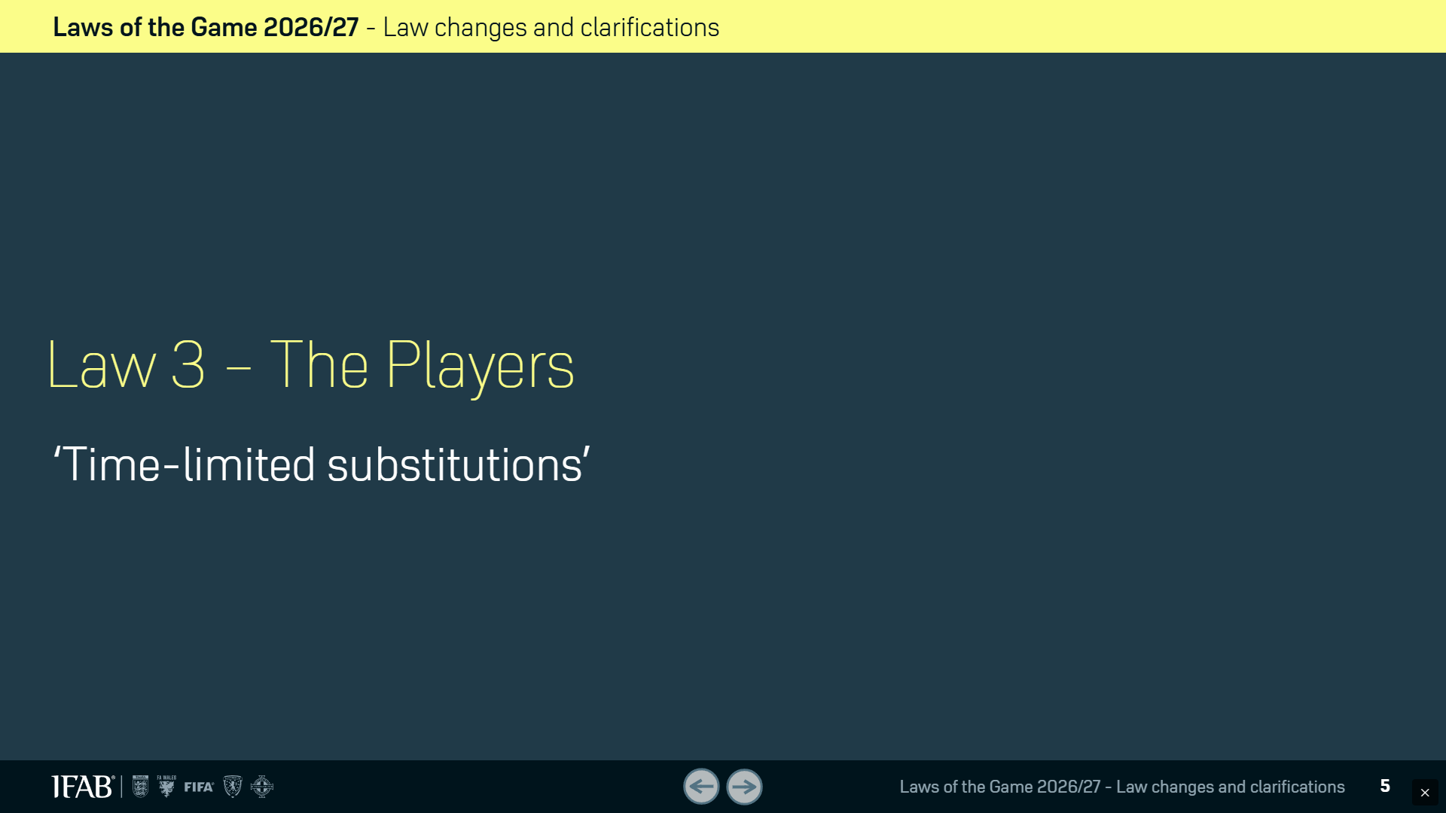
Law Changes

Slide 6
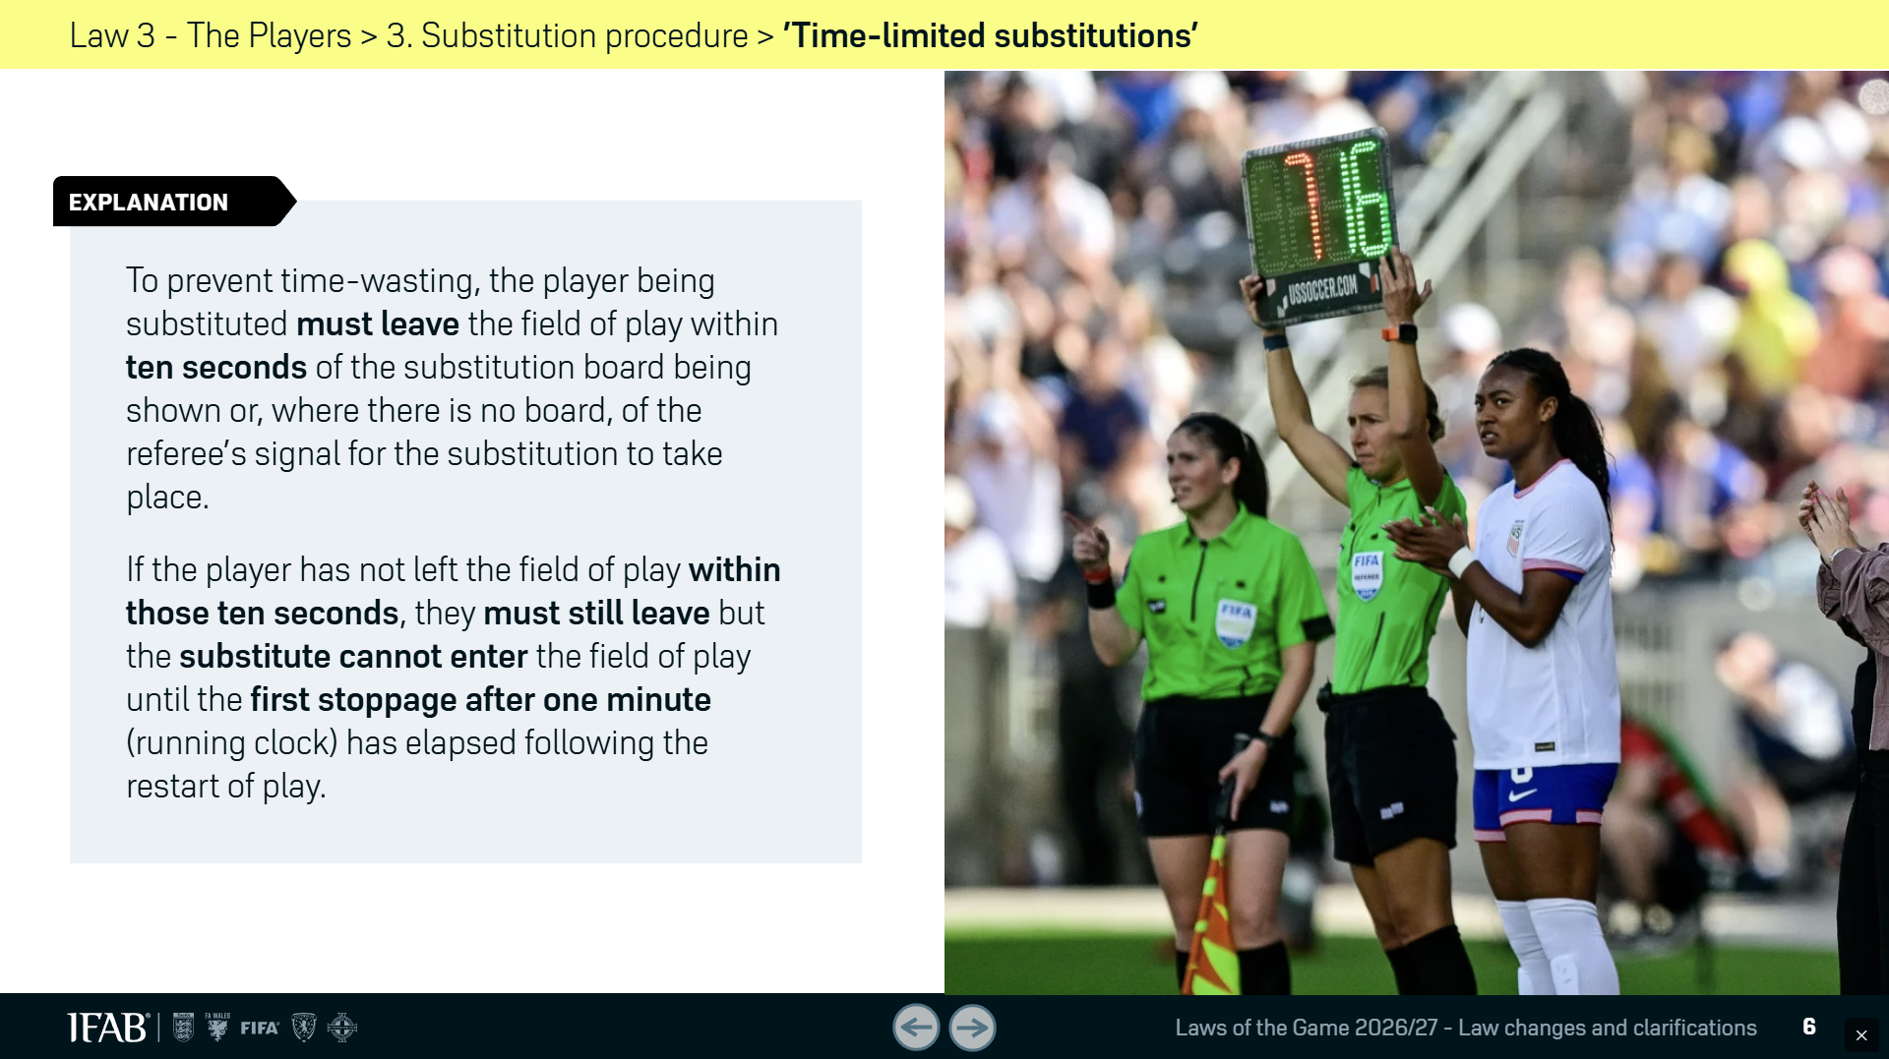
Law Changes

Slide 7
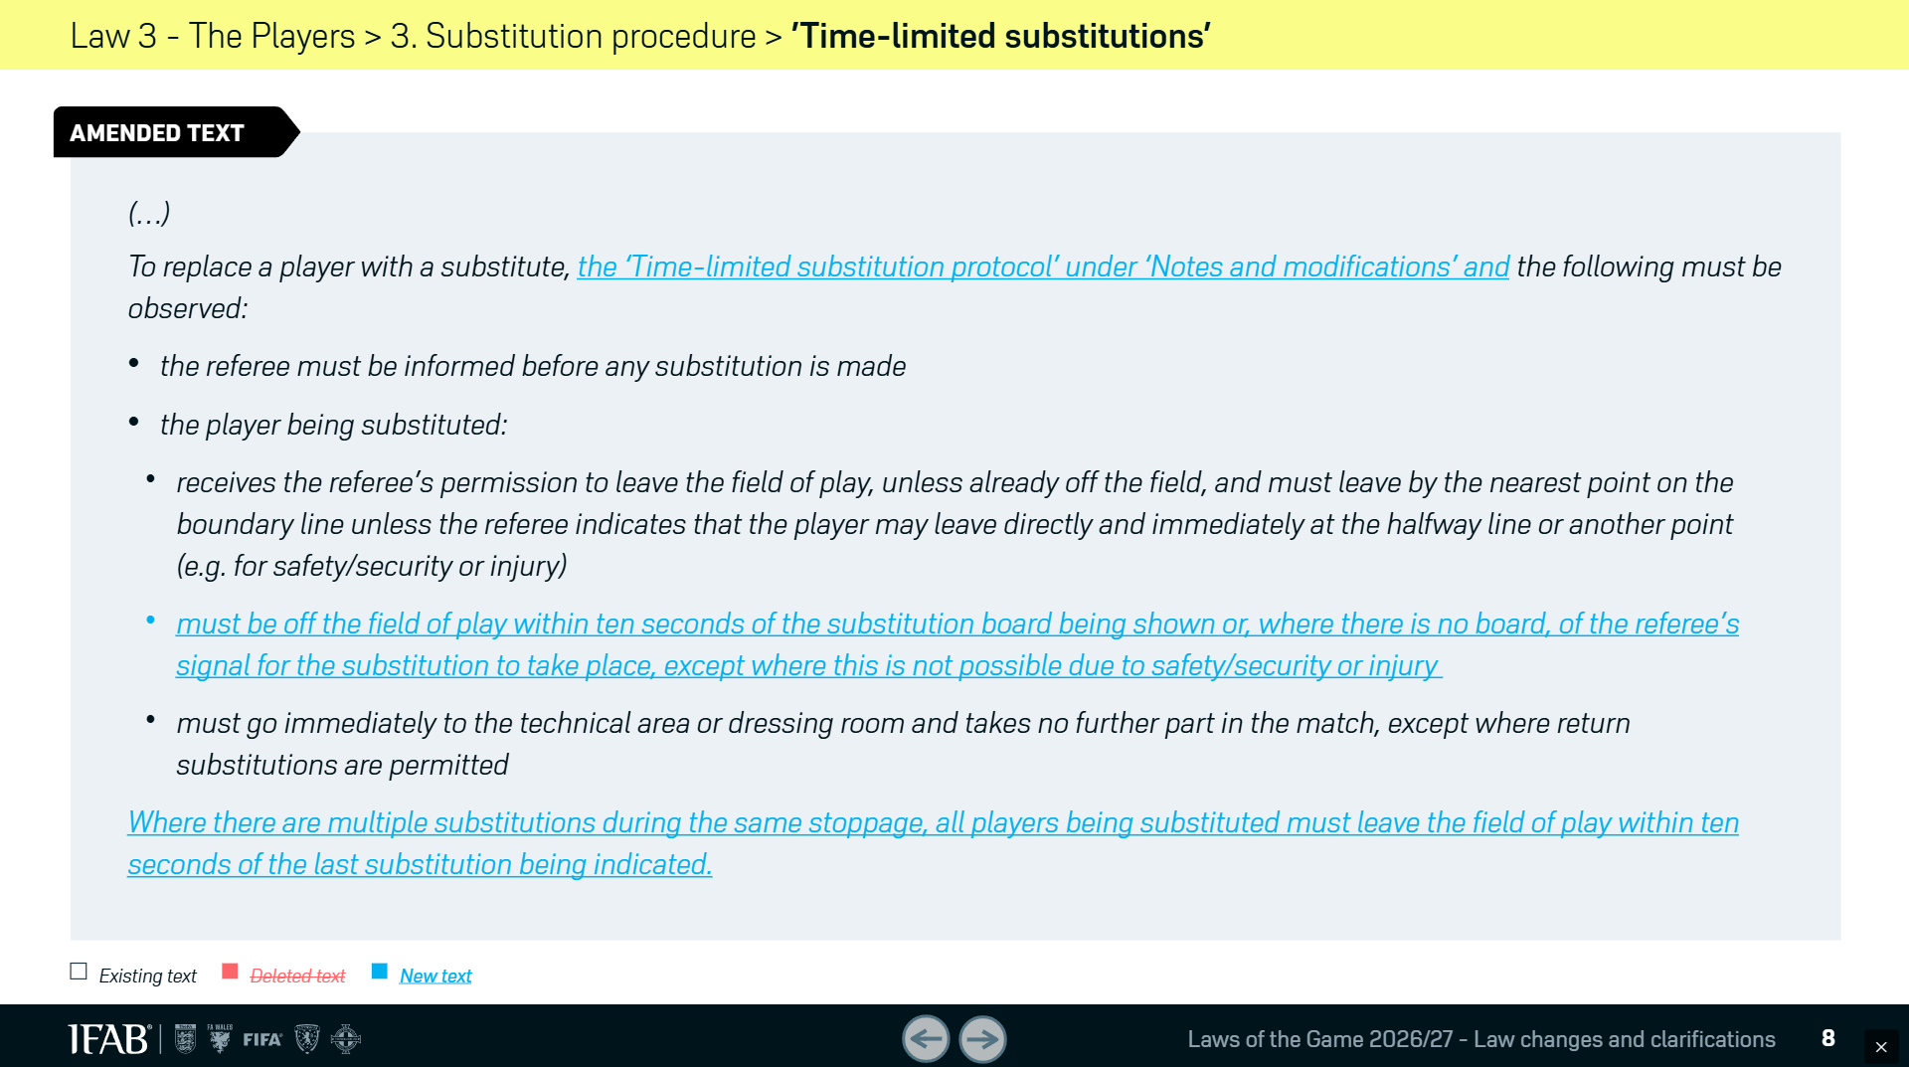
Law Changes

Slide 8
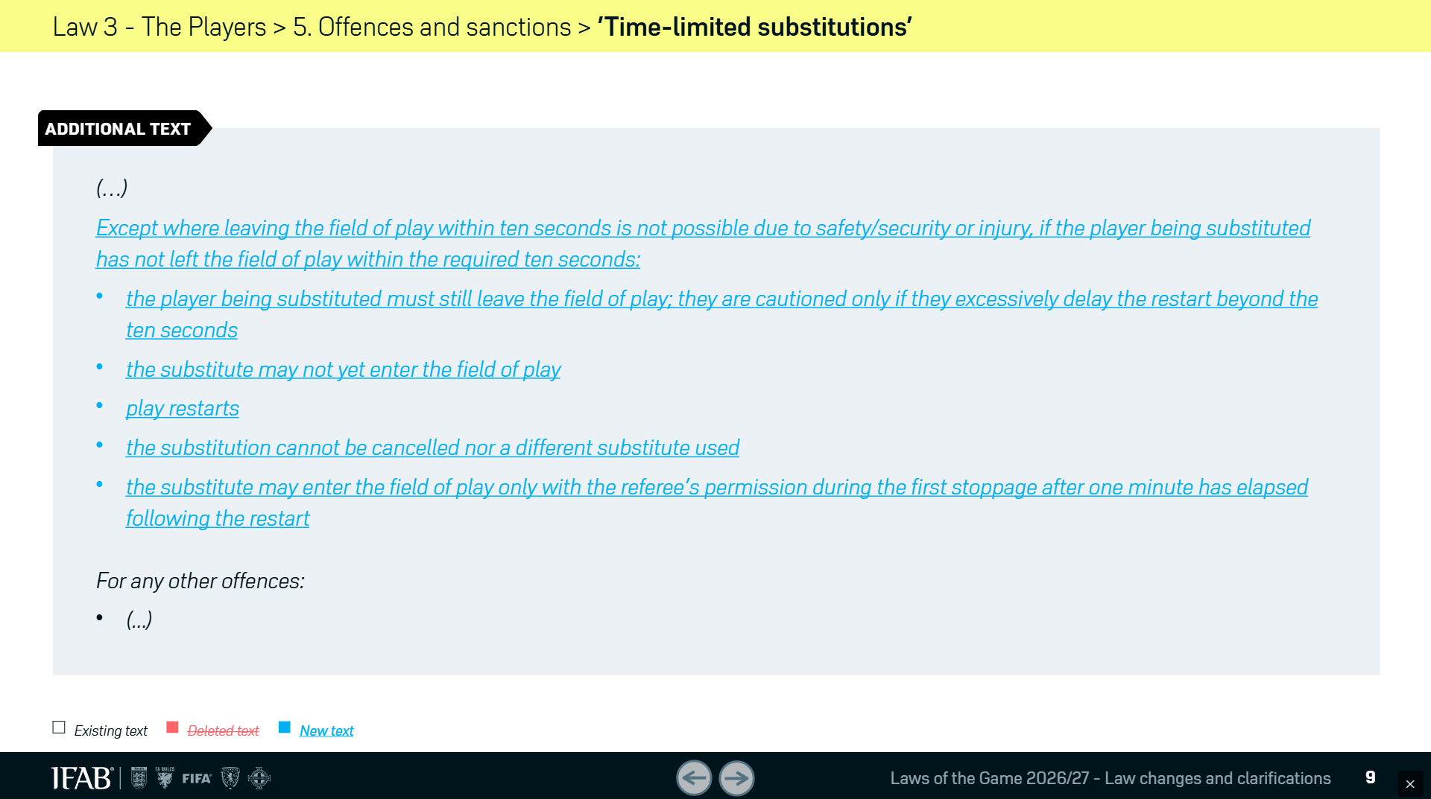
Law Changes

Slide 9
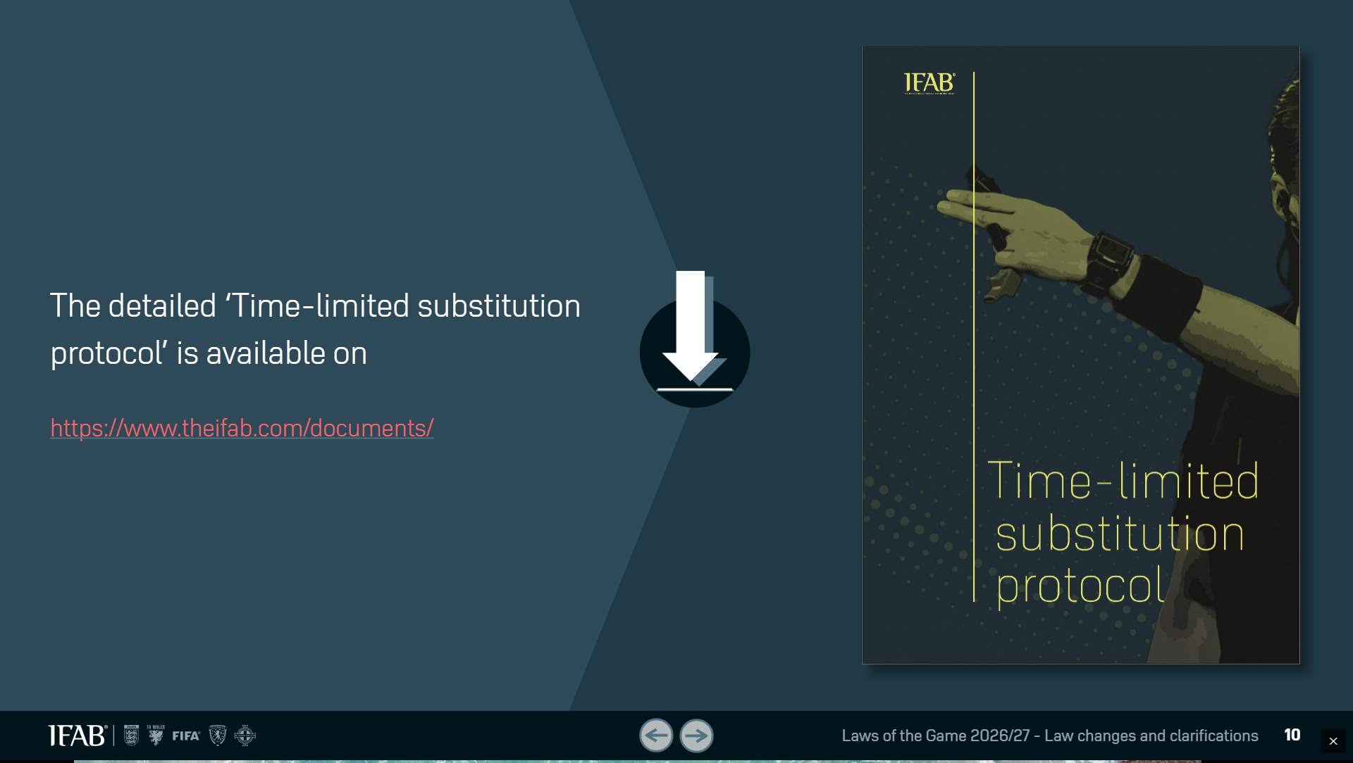
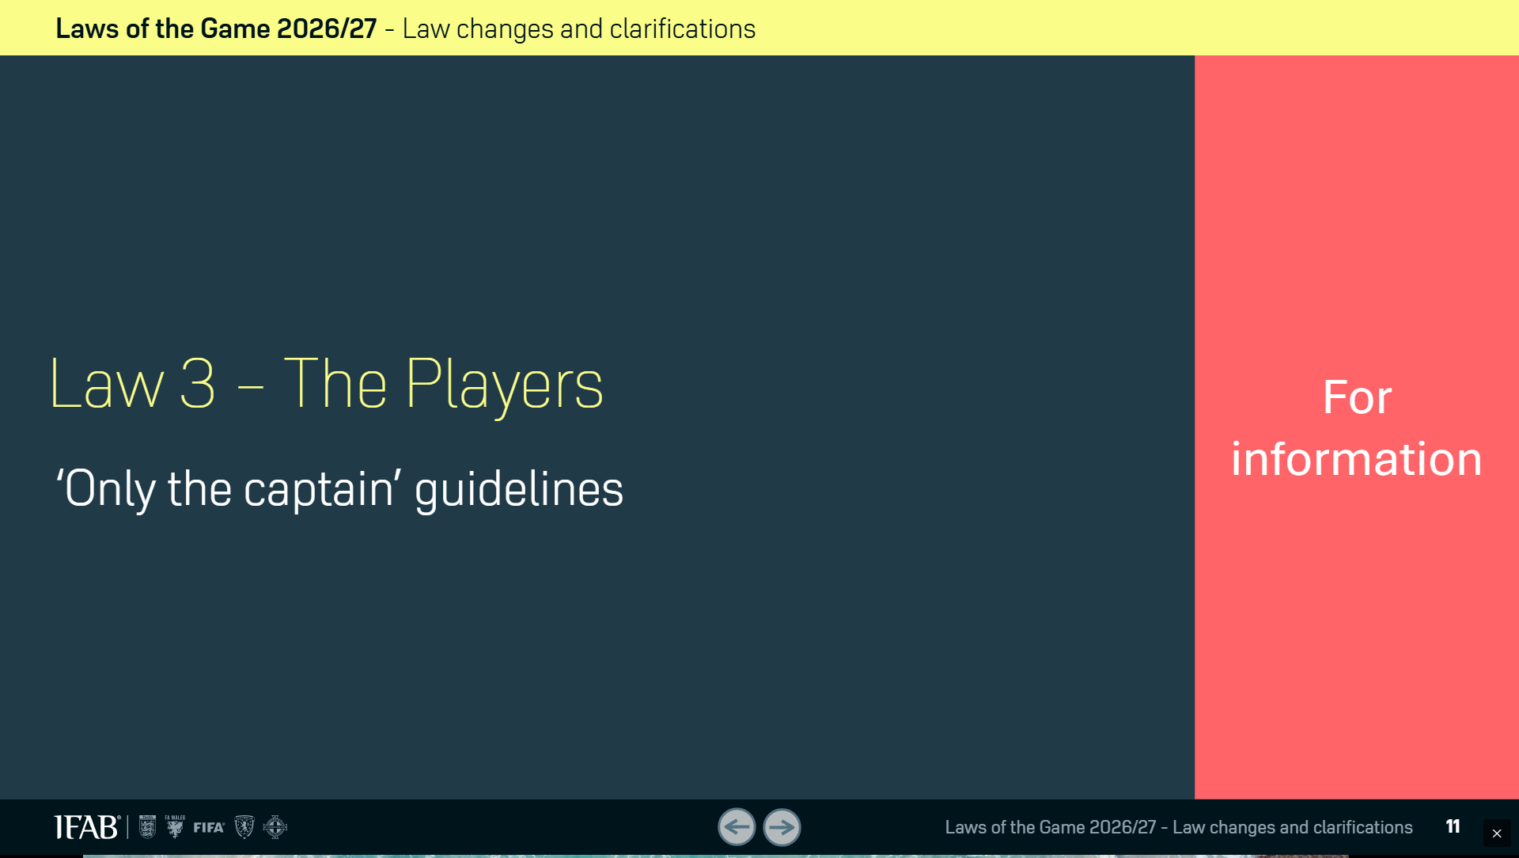
Law Changes

Slide 10
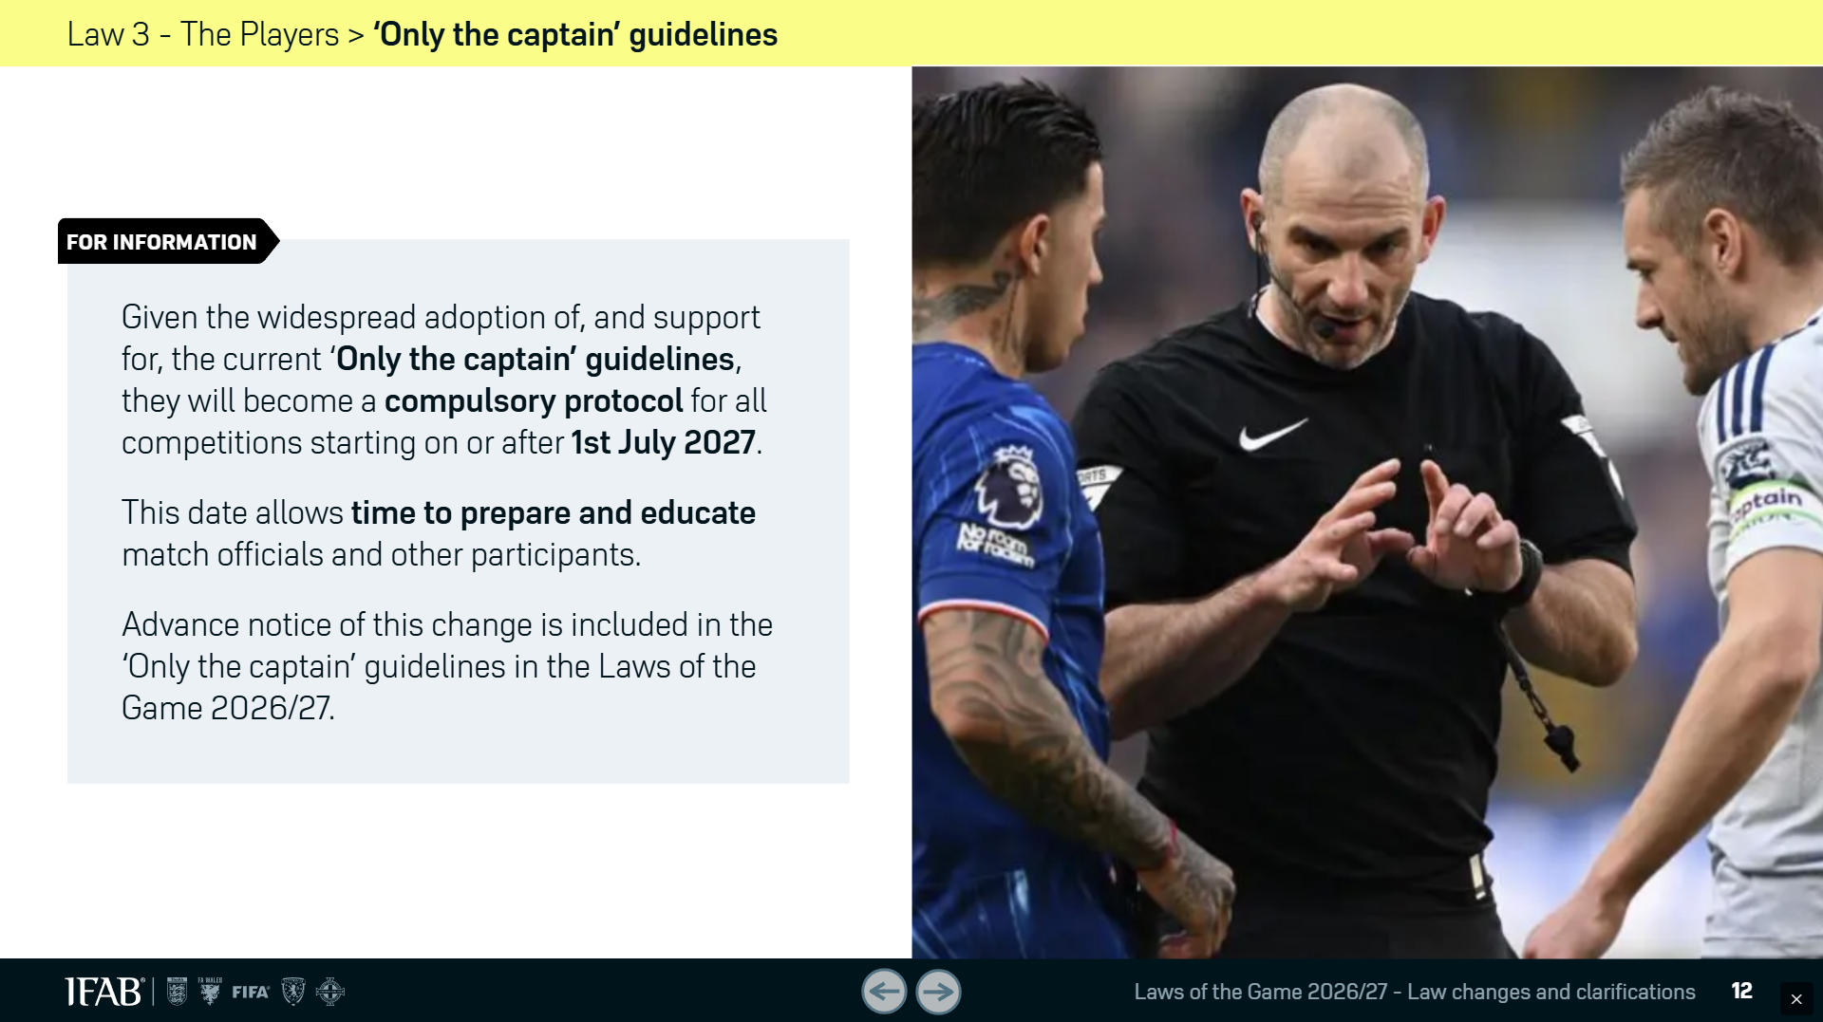
Law Changes

Slide 11
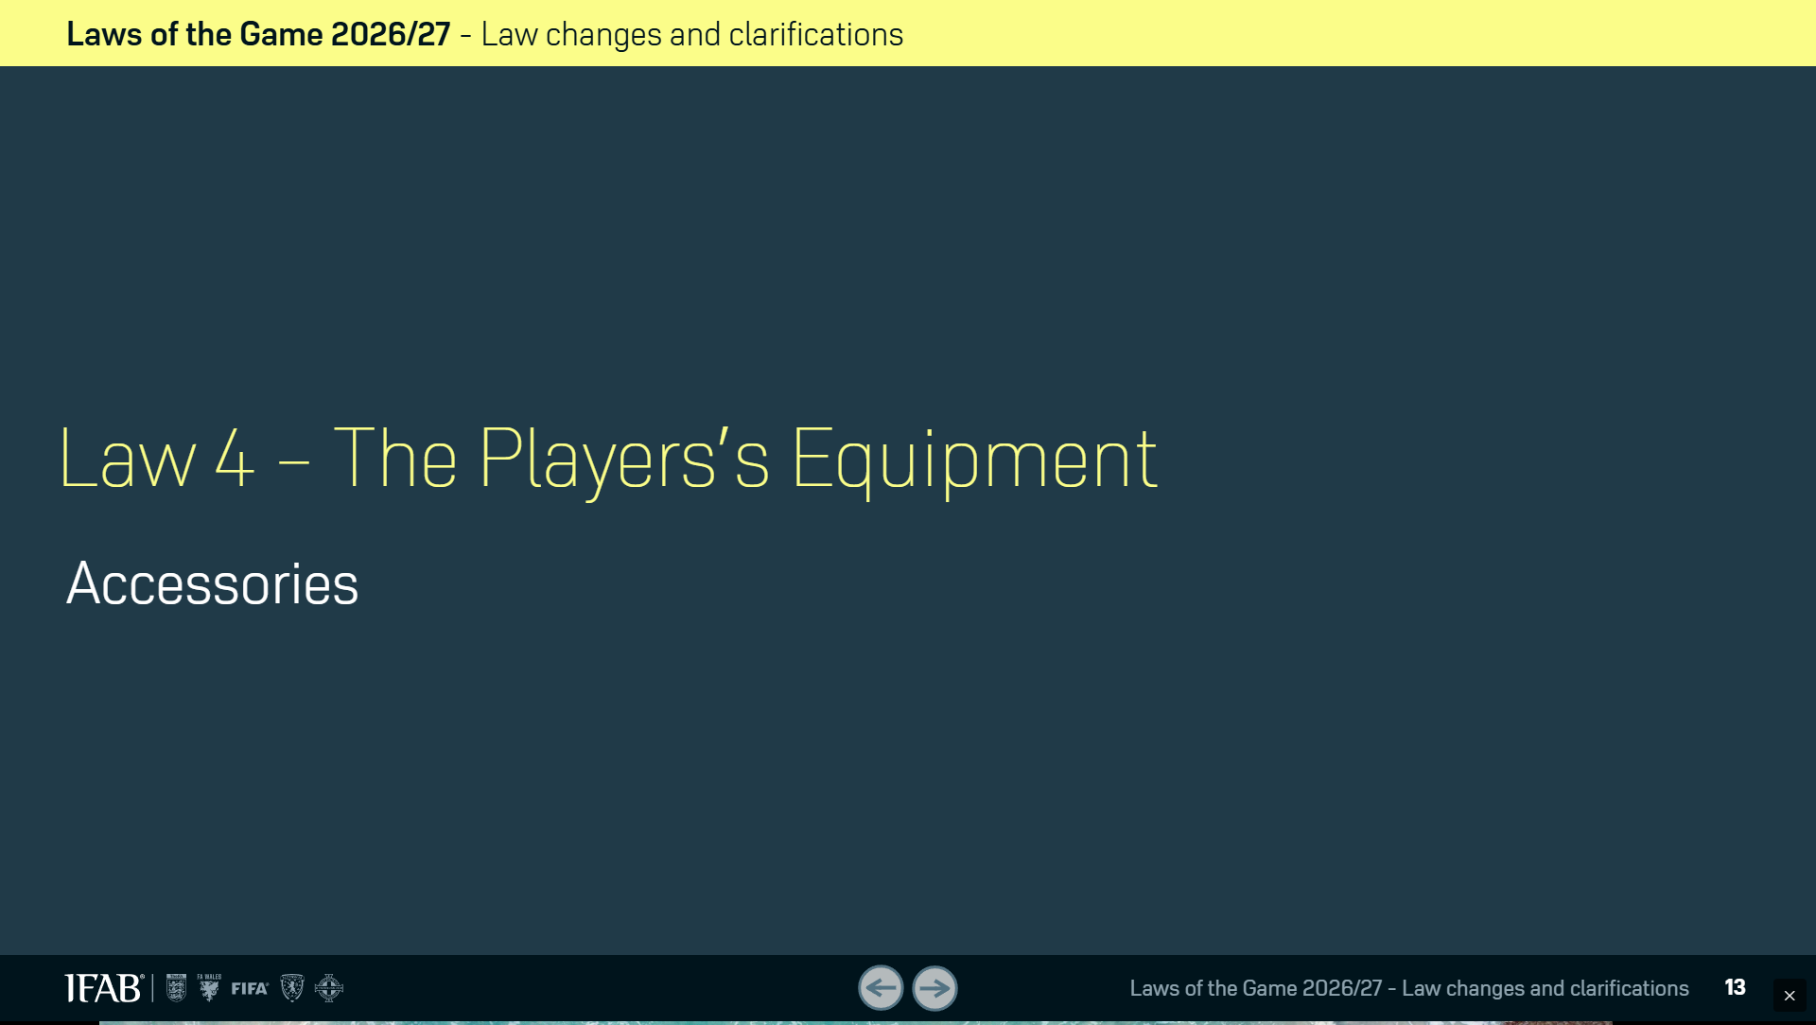
Law Changes

Slide 12
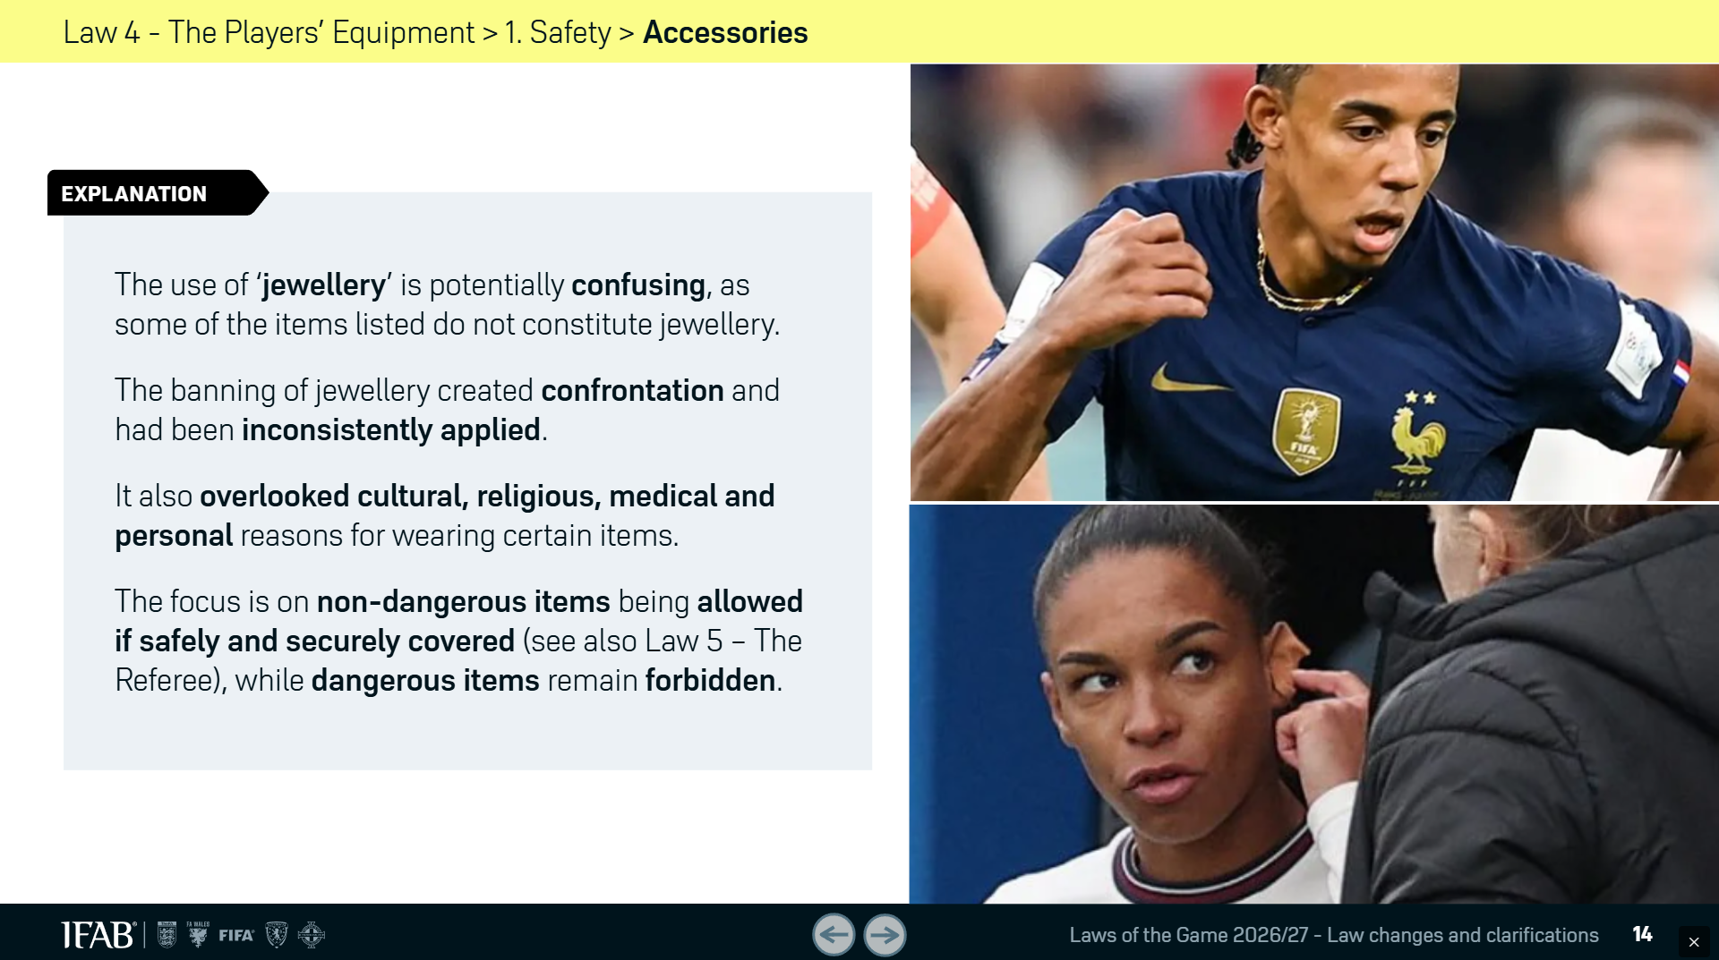
Law Changes

Slide 13
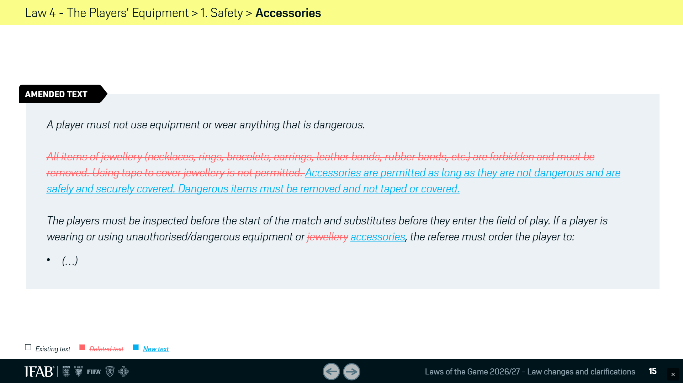
Law Changes

Slide 14
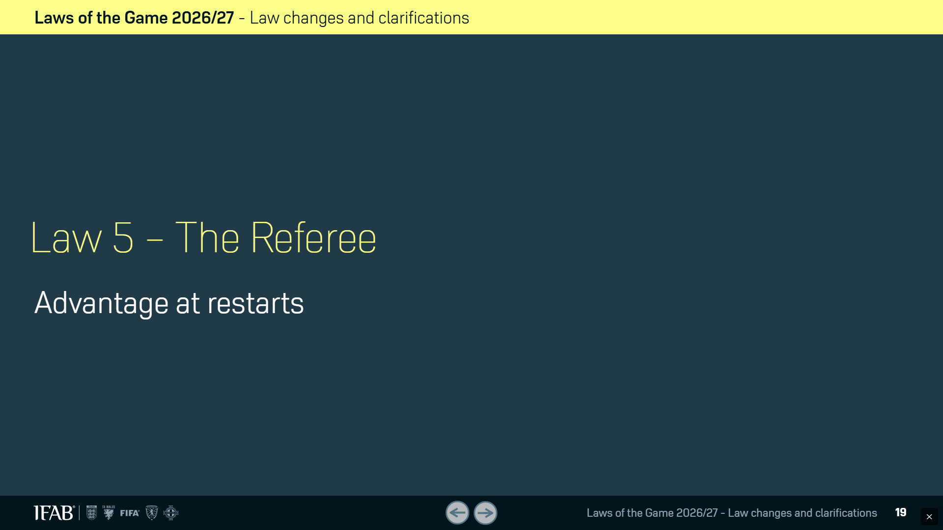
Law Changes

Slide 15
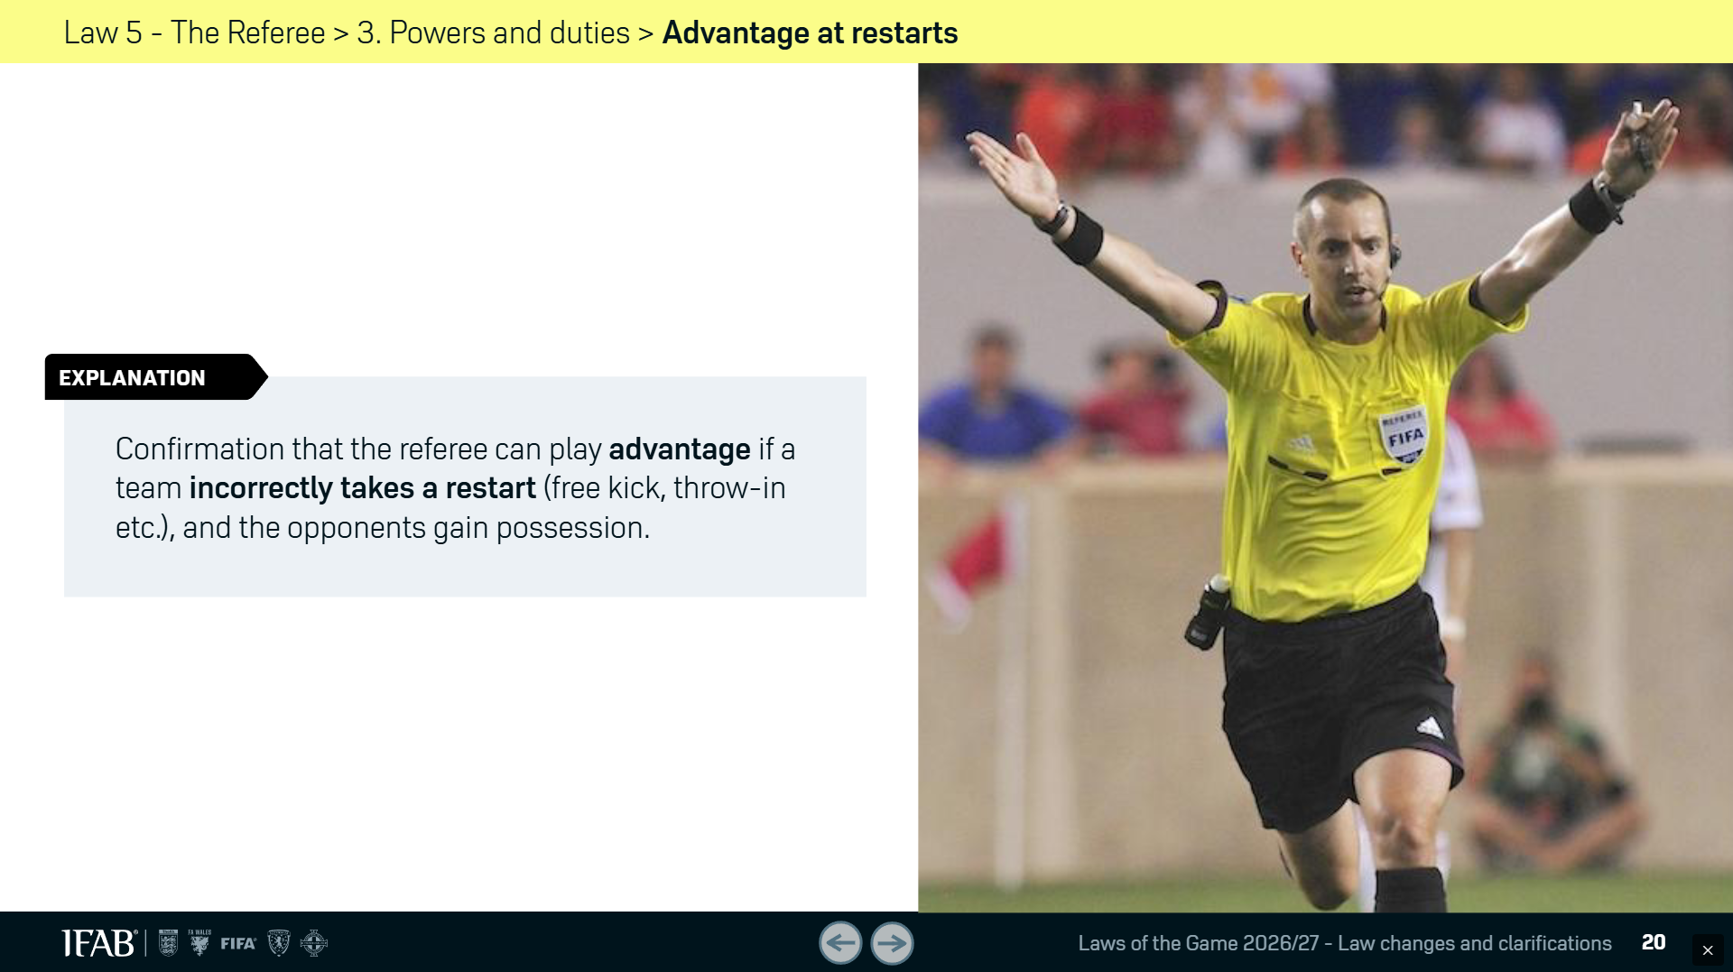
Law Changes

Slide 16
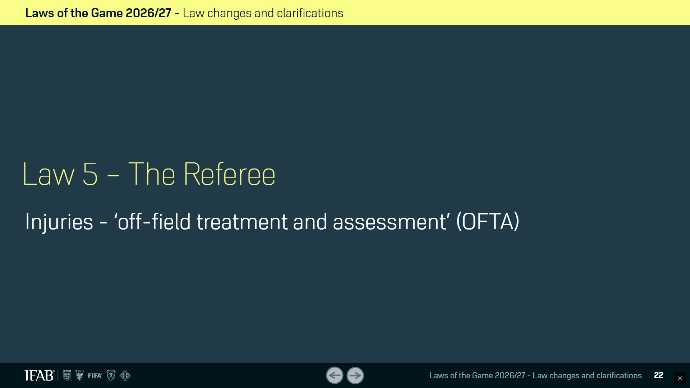
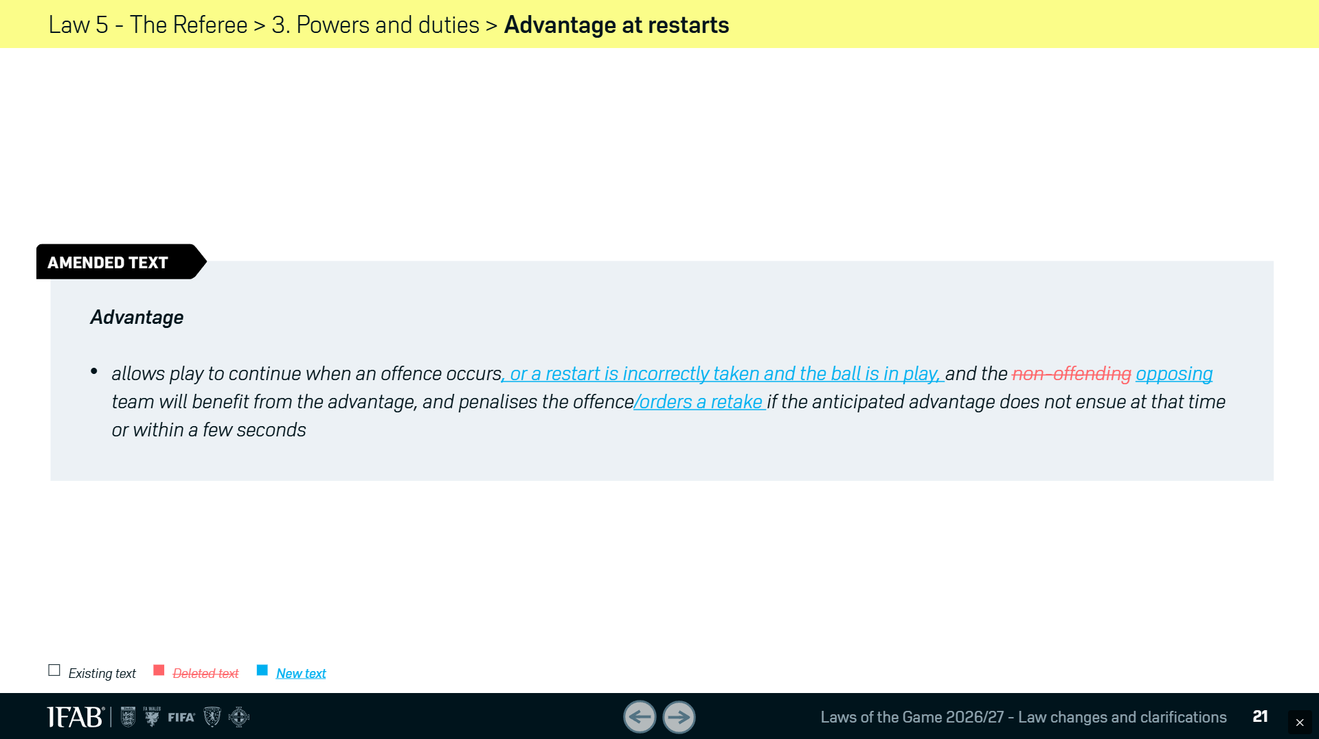
Law Changes

Slide 17
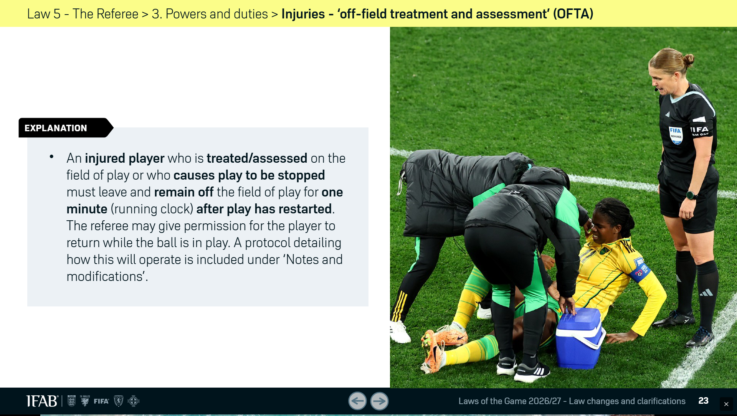
Law Changes

Slide 18
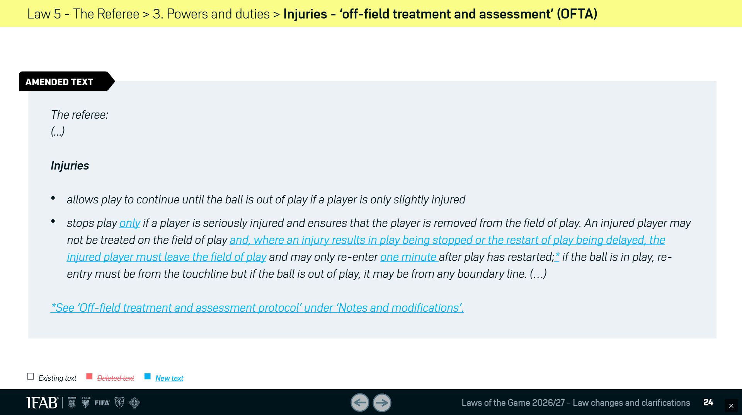
Law Changes

Slide 19
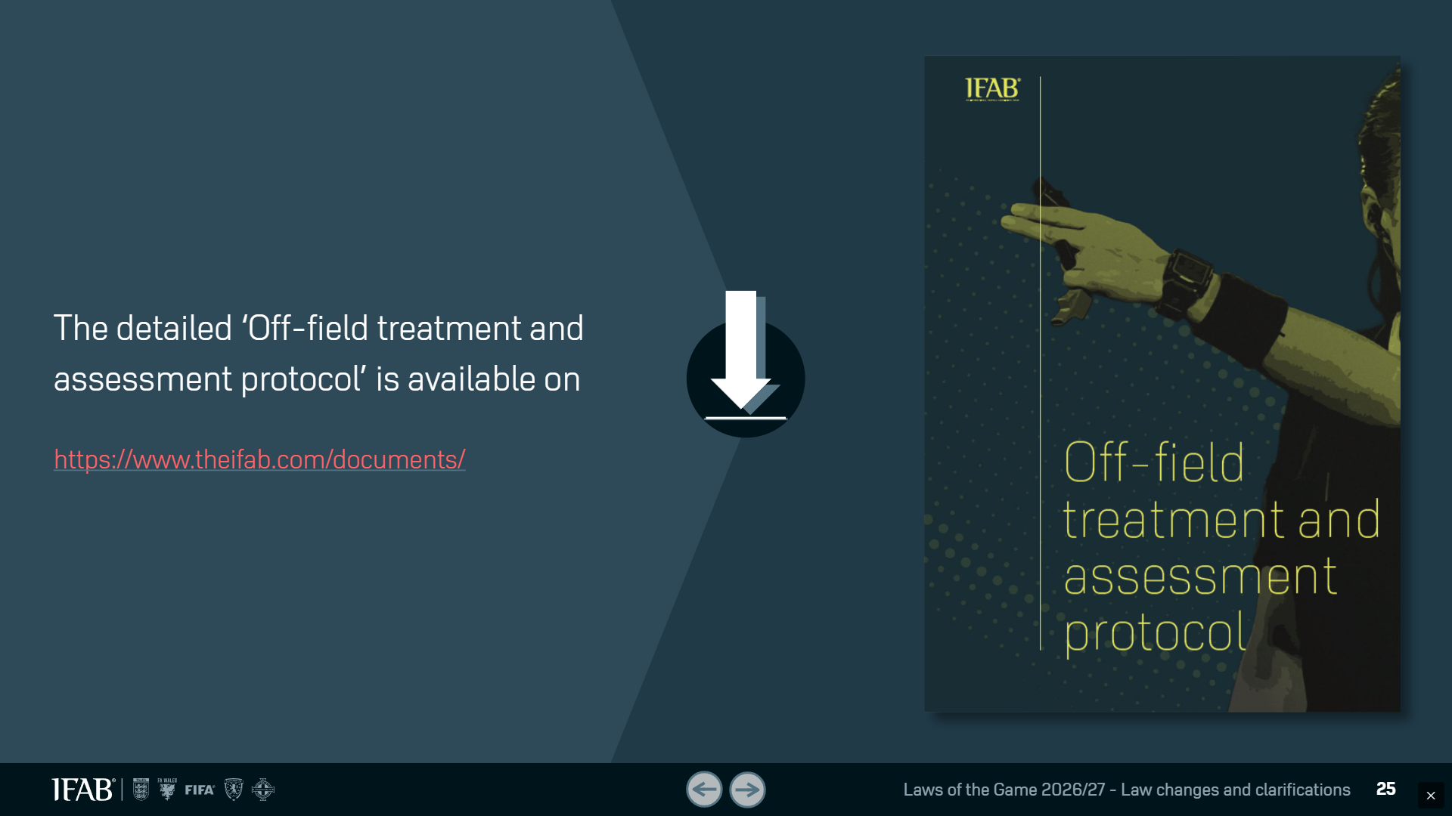
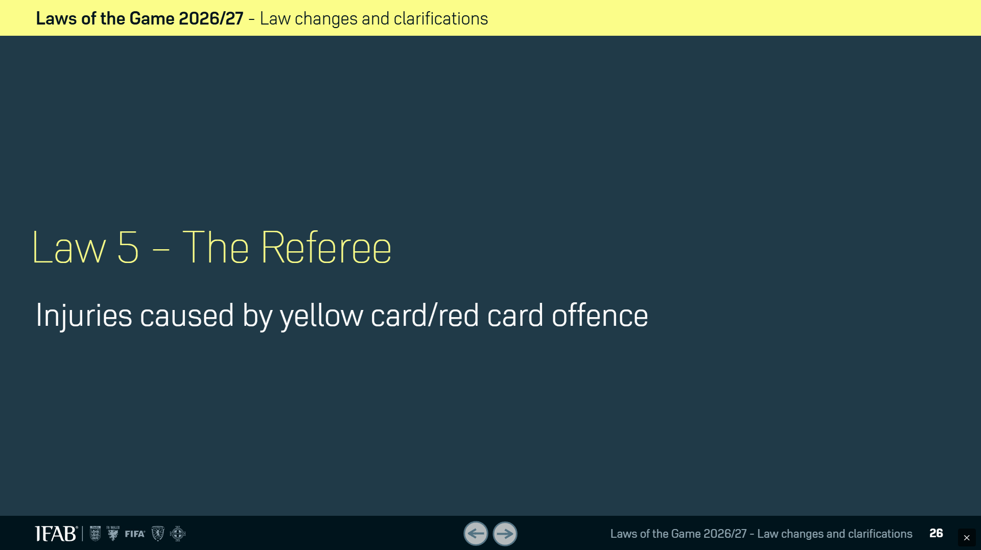
Law Changes

Slide 20
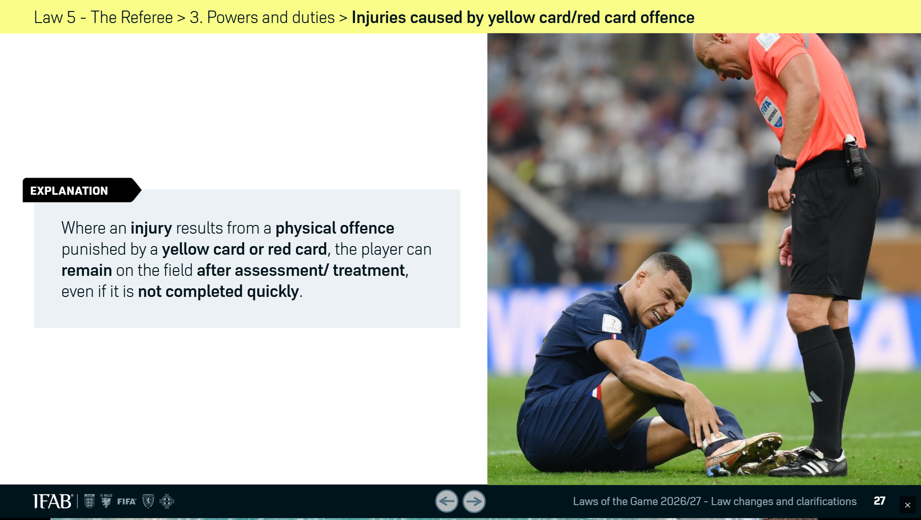
Law Changes

Slide 21
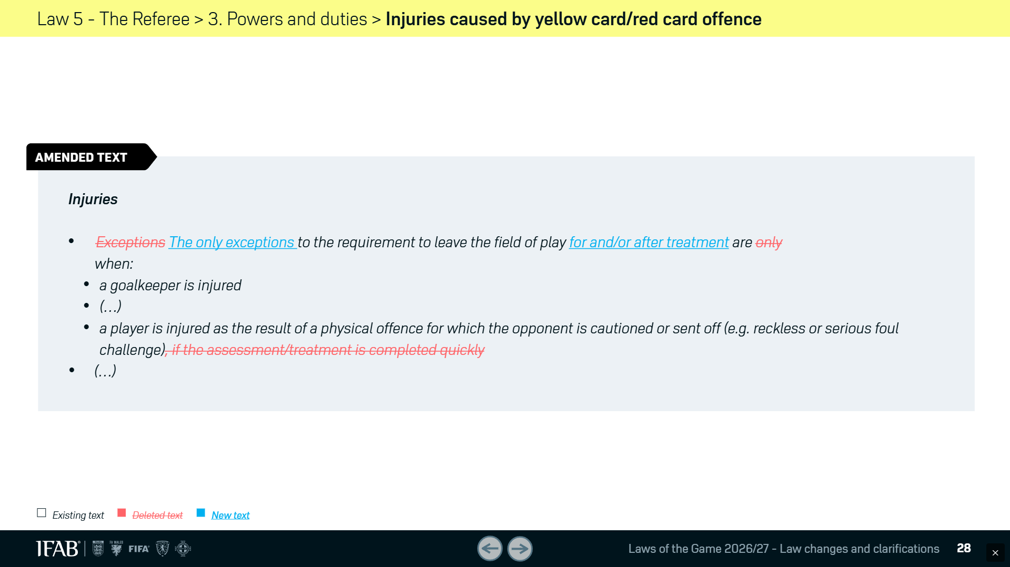
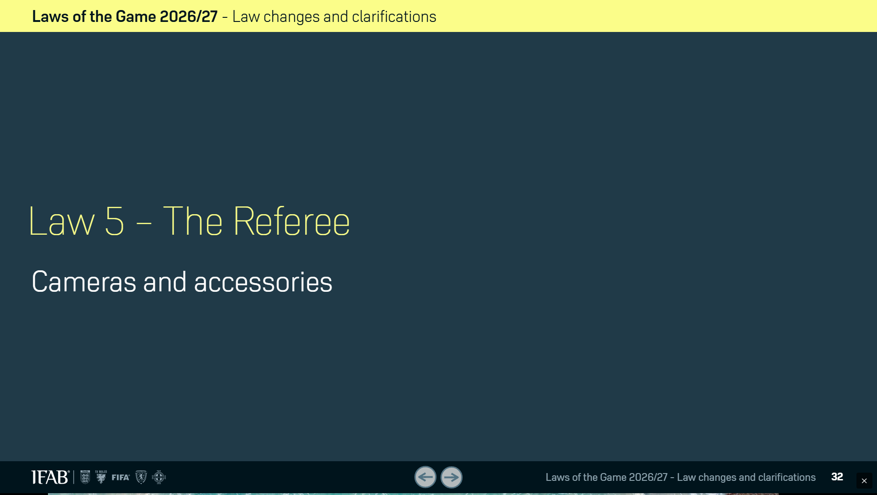
Law Changes

Slide 22
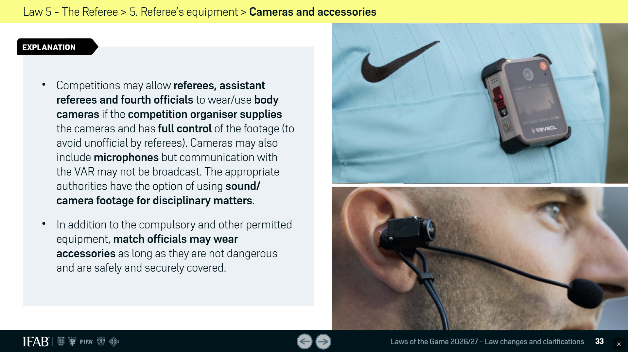
Law Changes

Slide 23
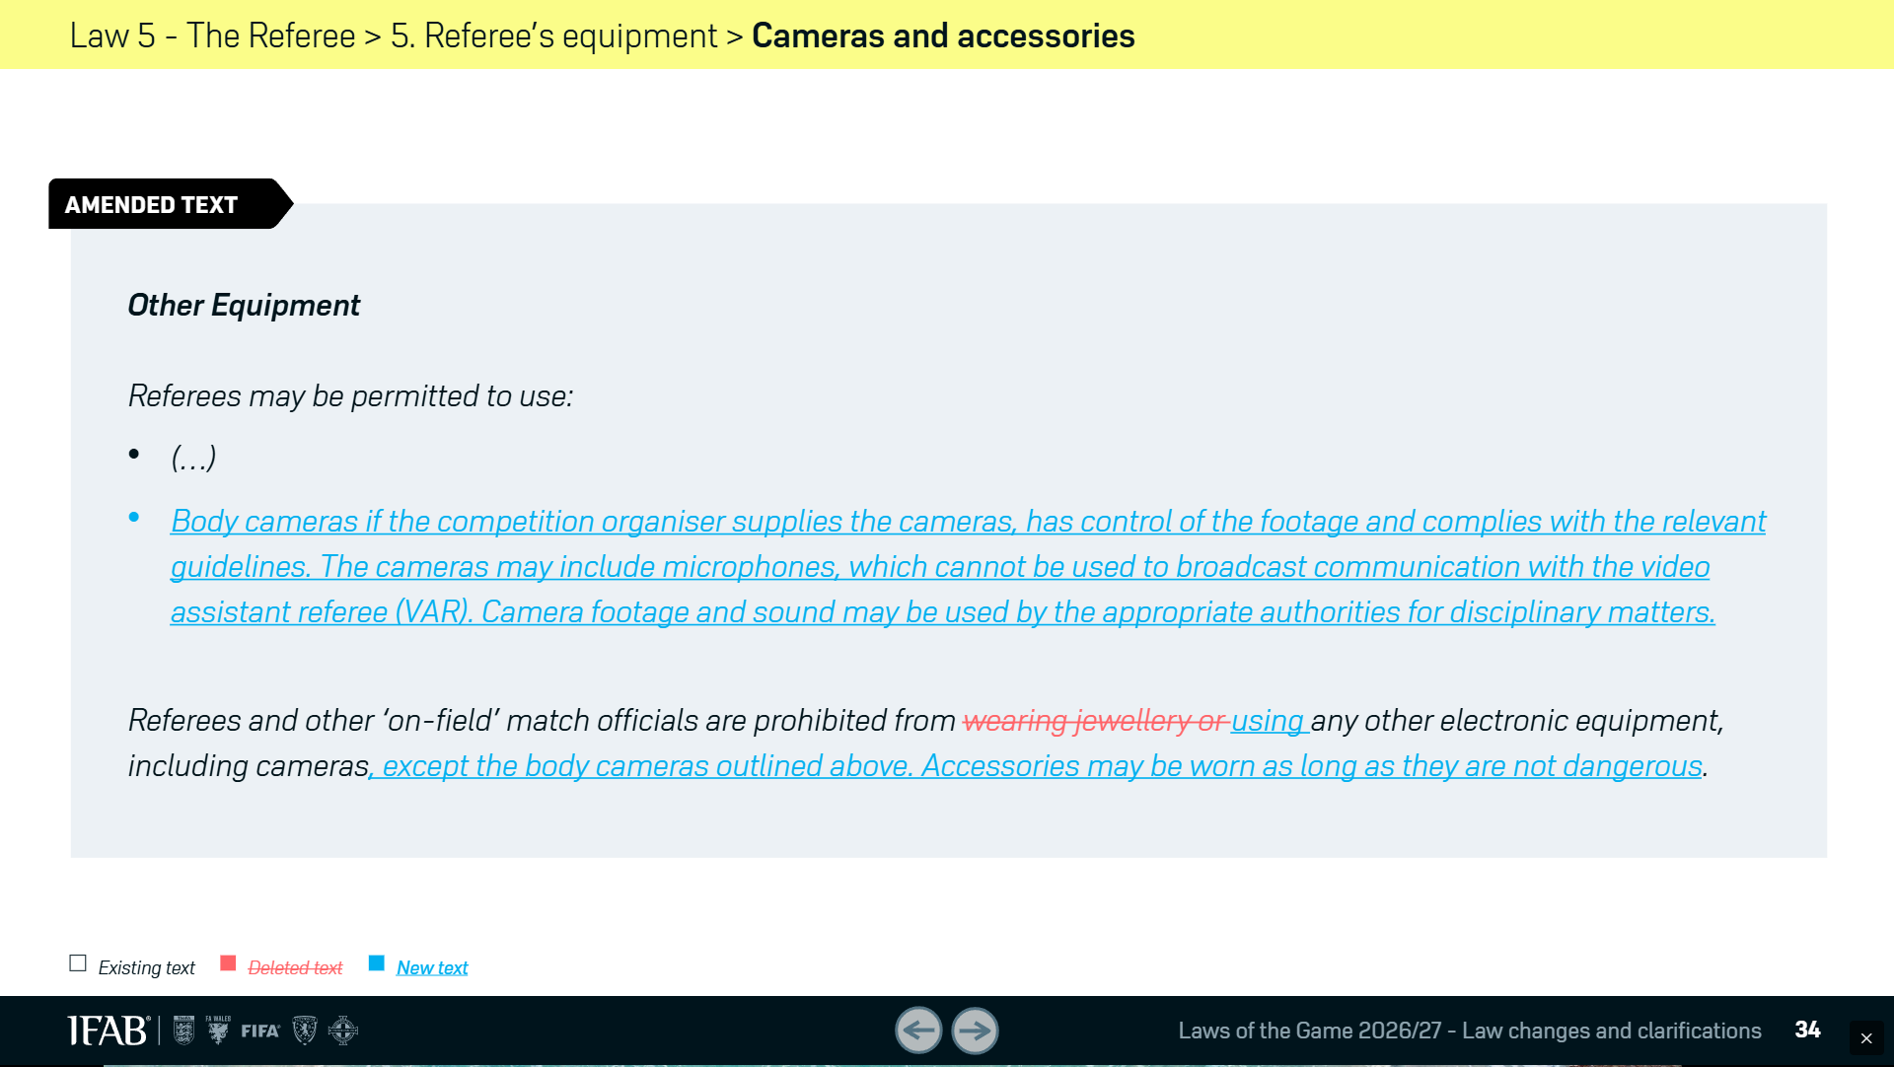
Law Changes

Slide 24
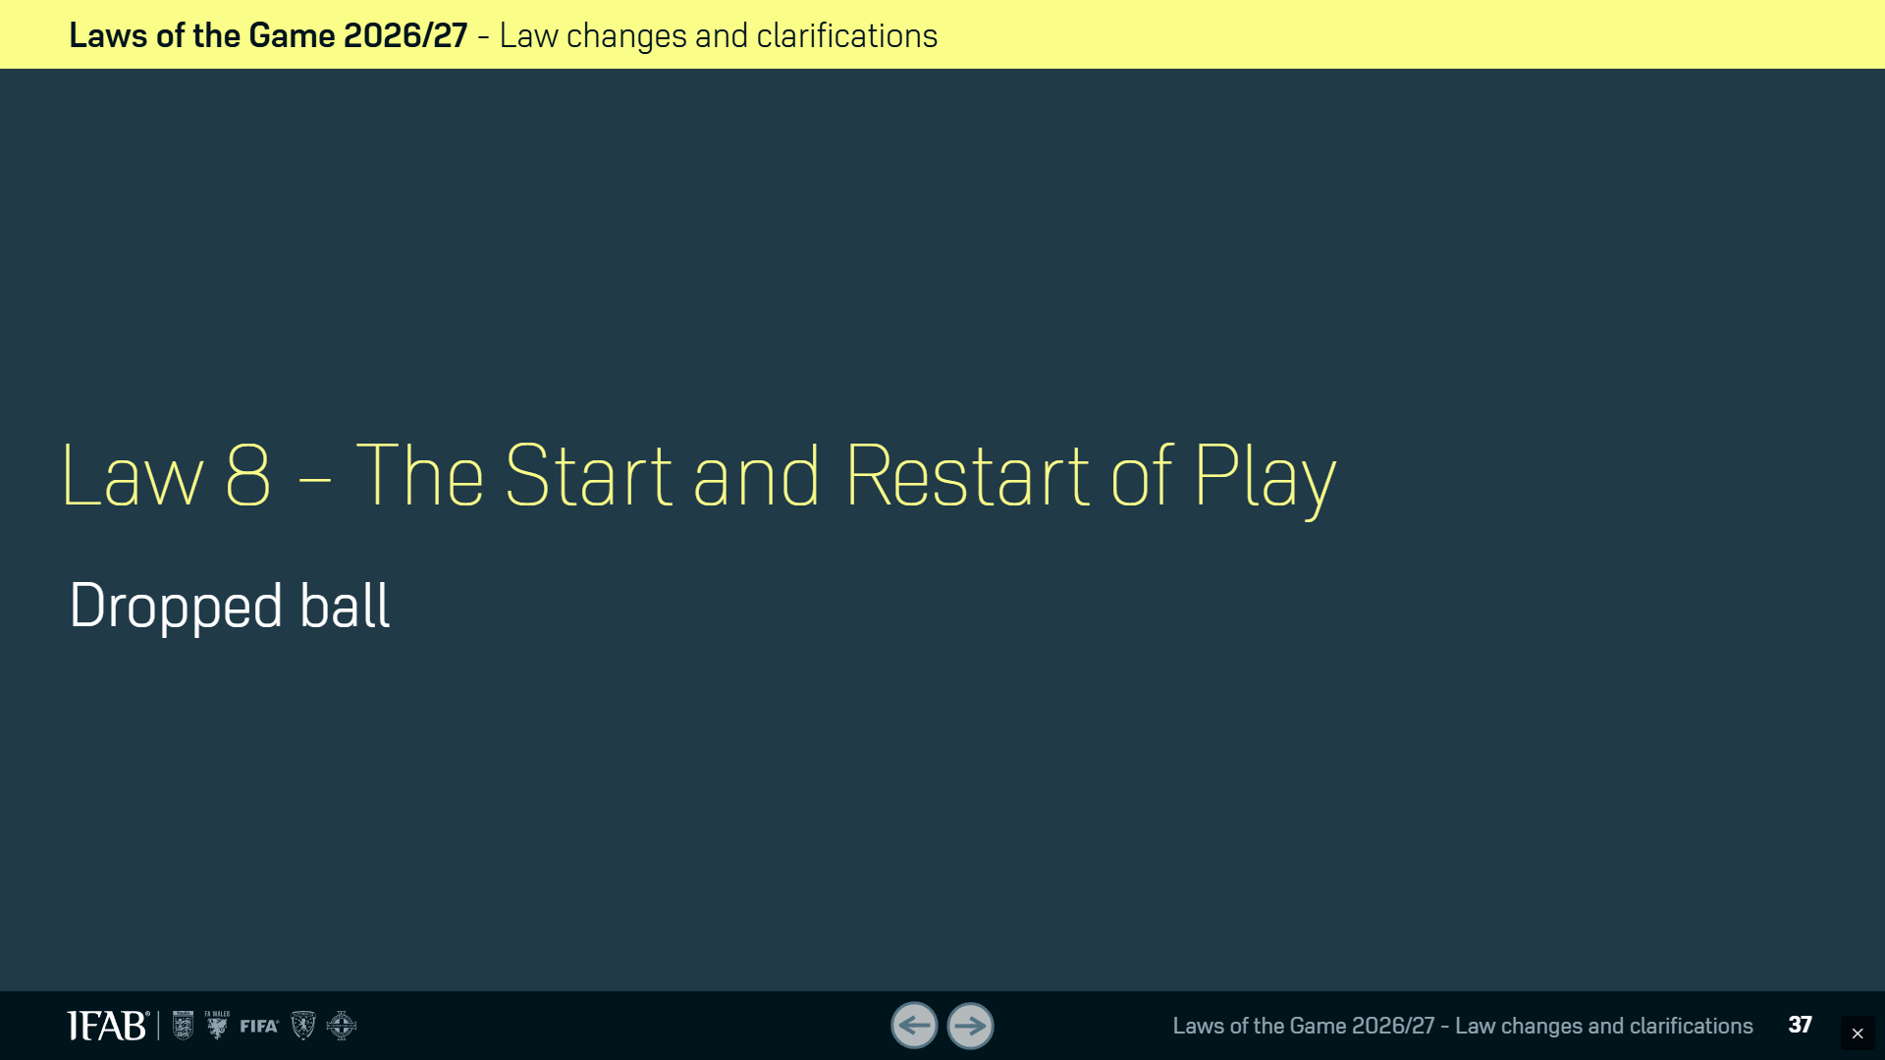
Law Changes

Slide 25
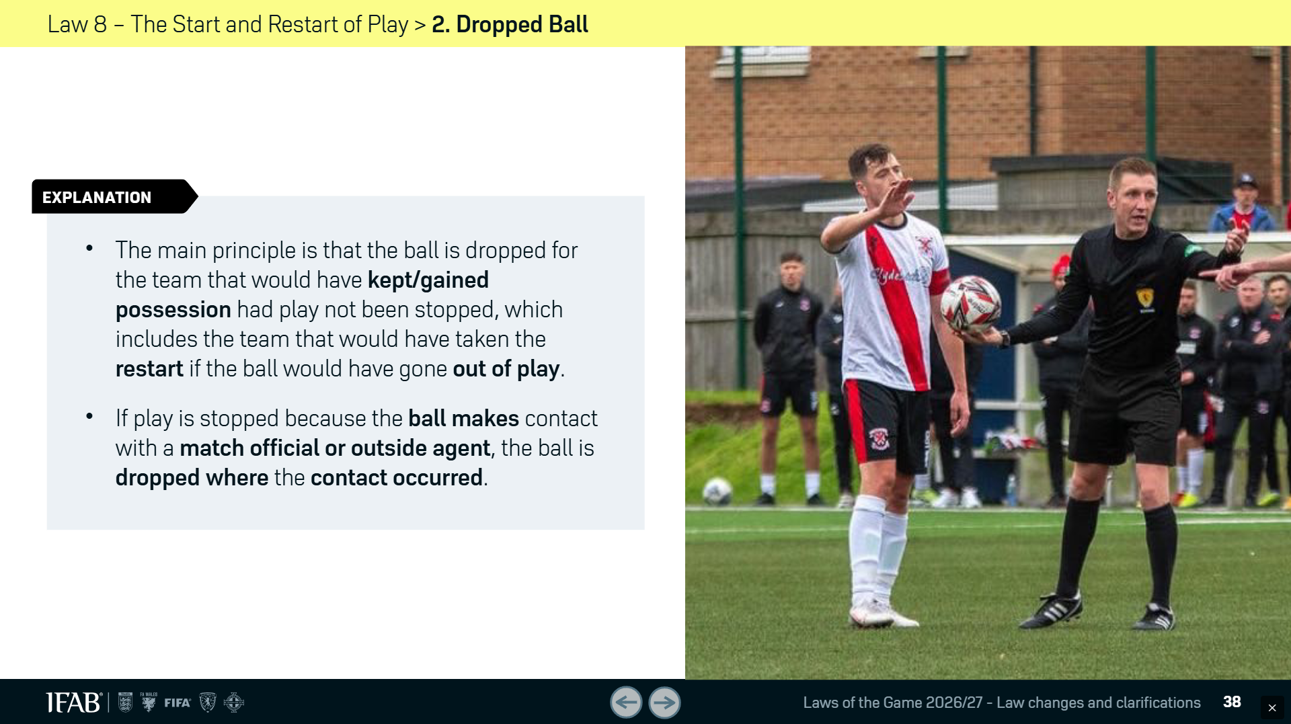
Law Changes

Slide 26
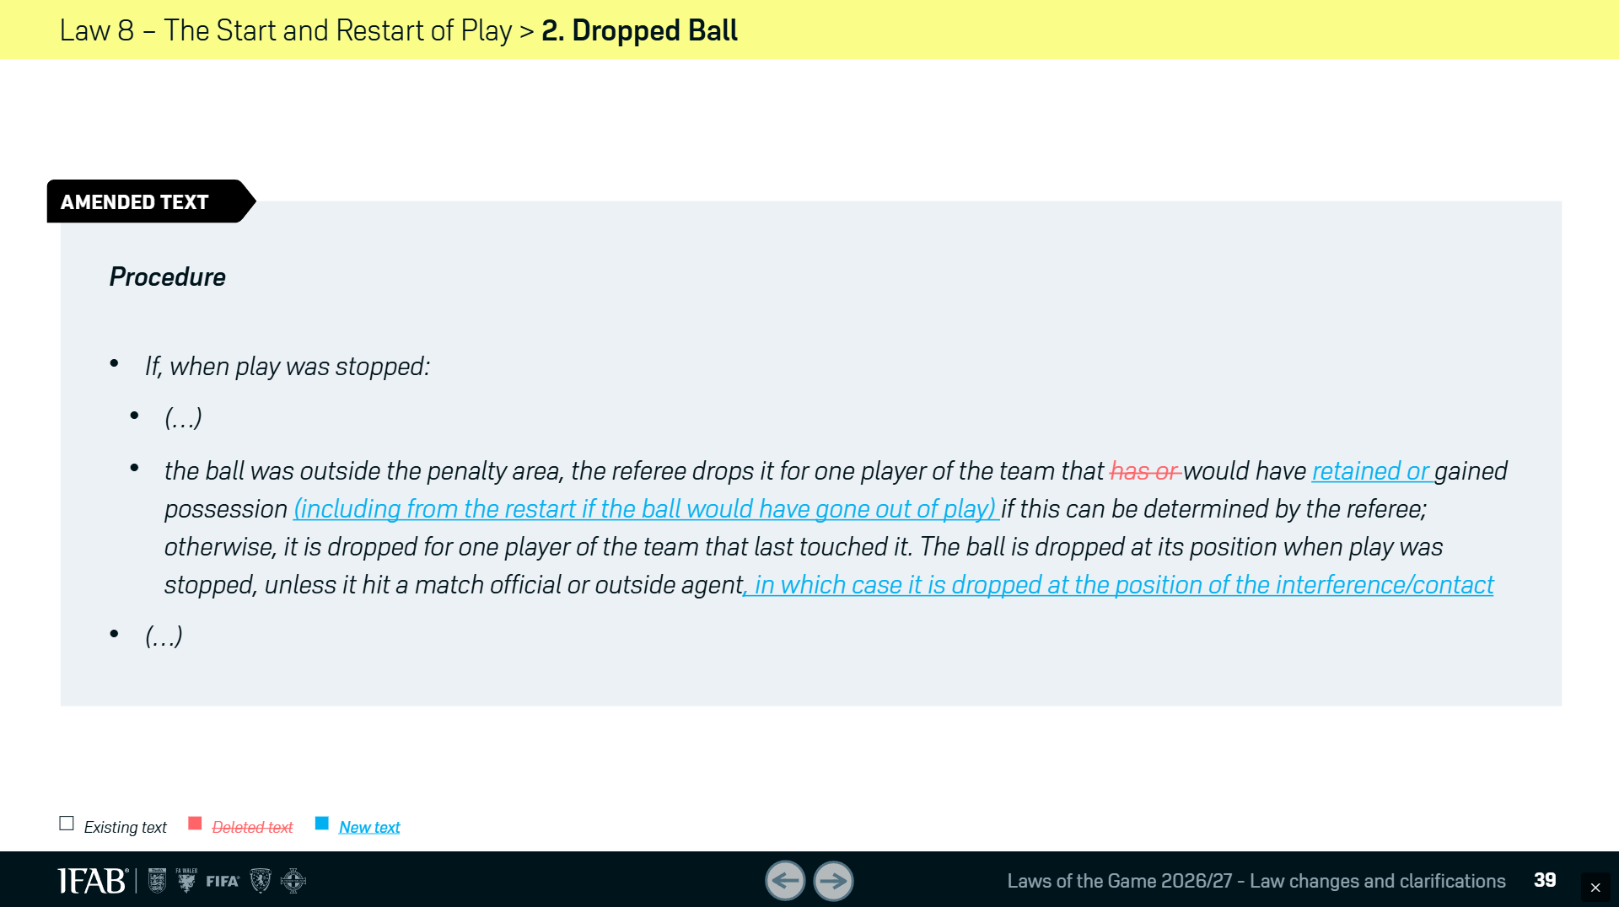
Law Changes

Slide 27

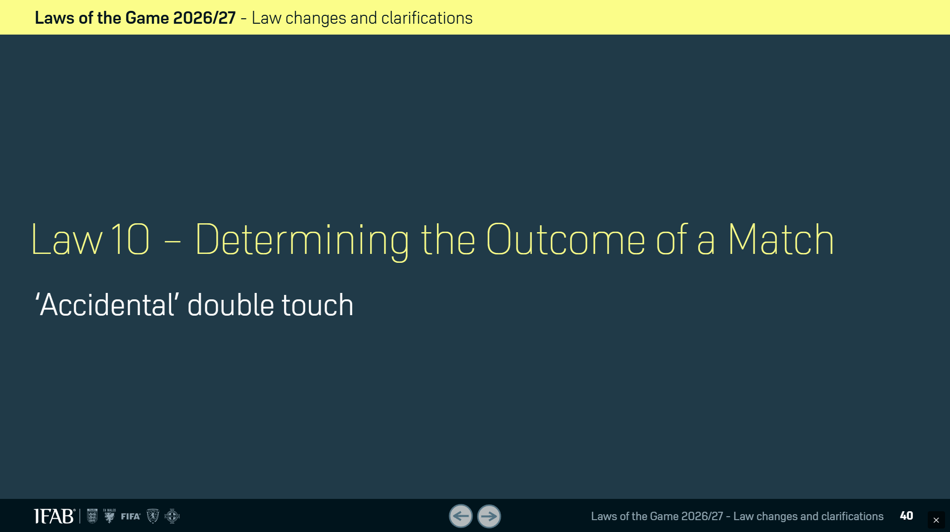
Law Changes

Slide 28
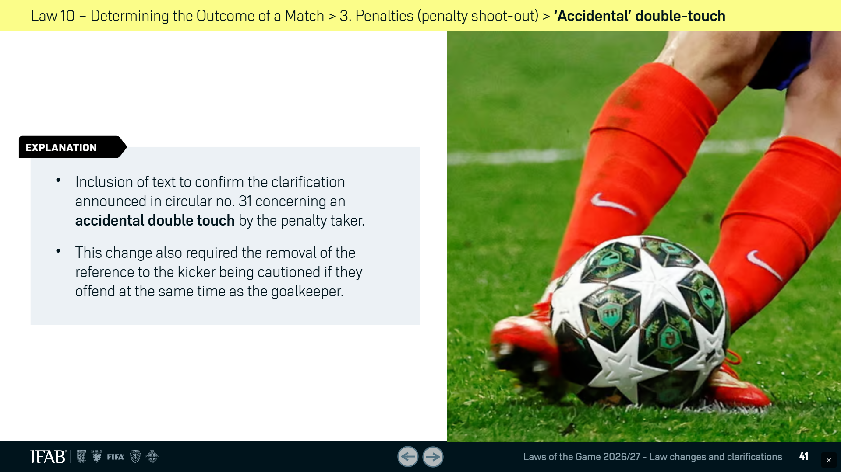
Law Changes

Slide 29
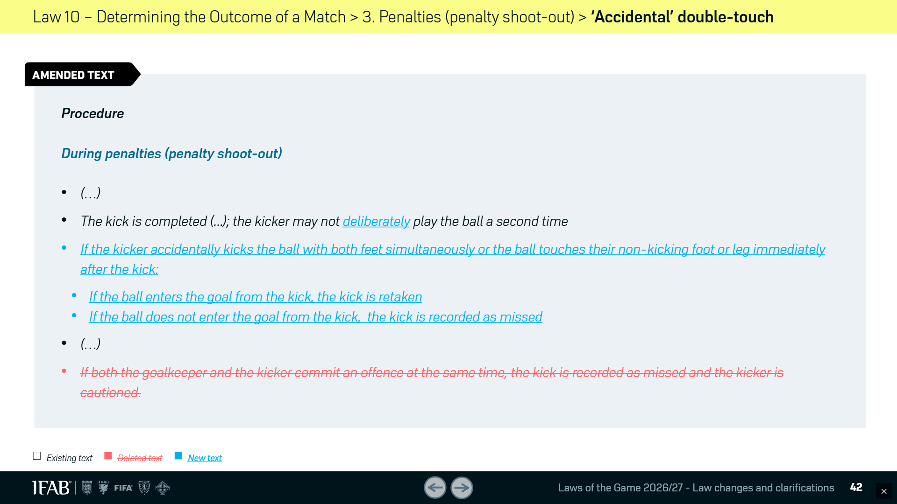
Law Changes

Slide 30
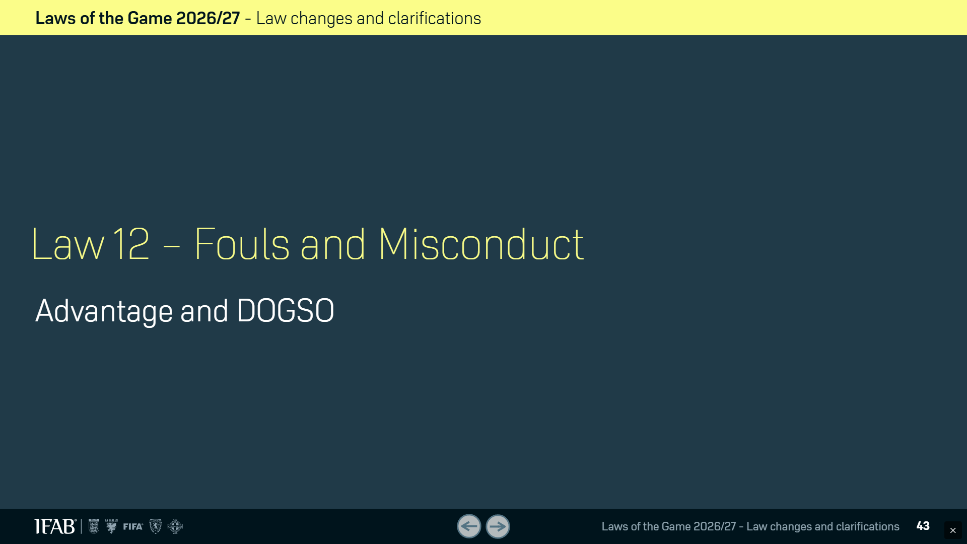
Law Changes

Slide 31
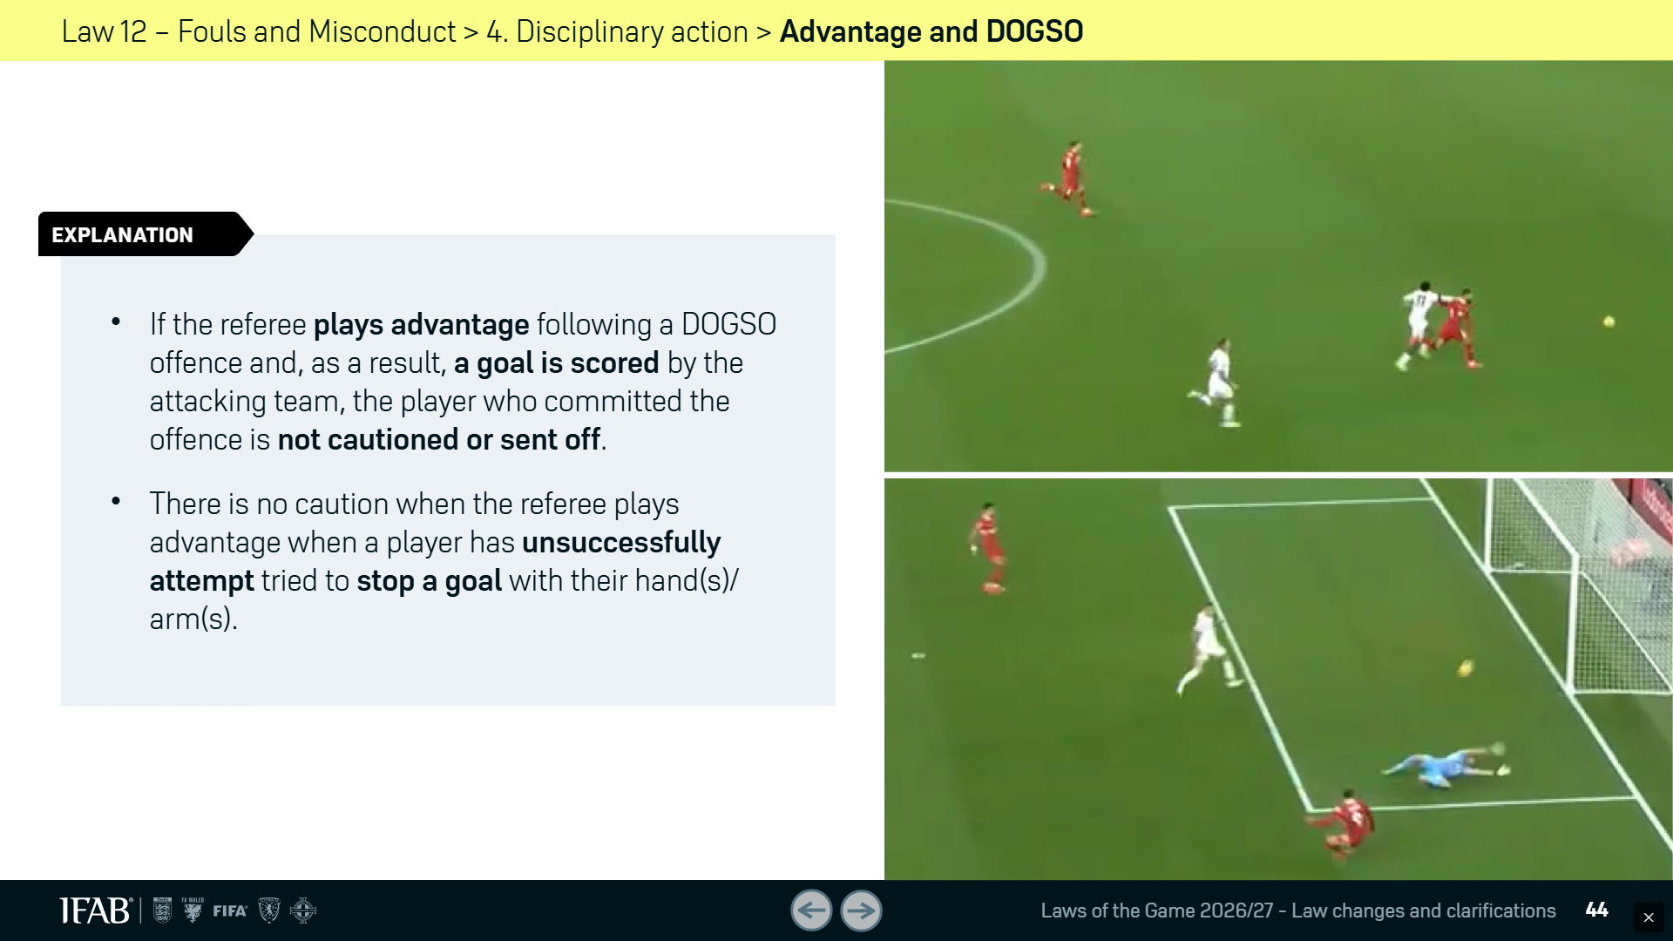
Law Changes

Slide 32
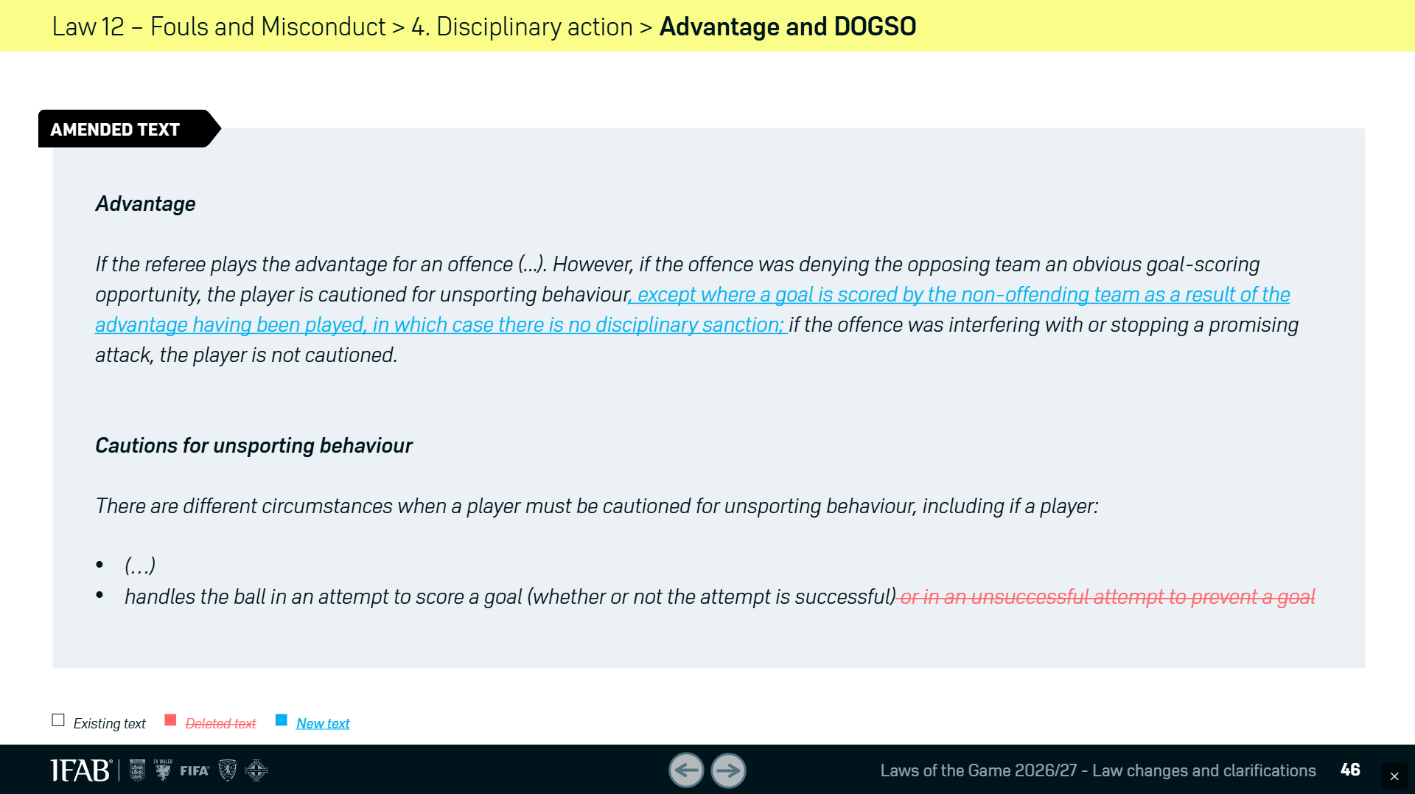
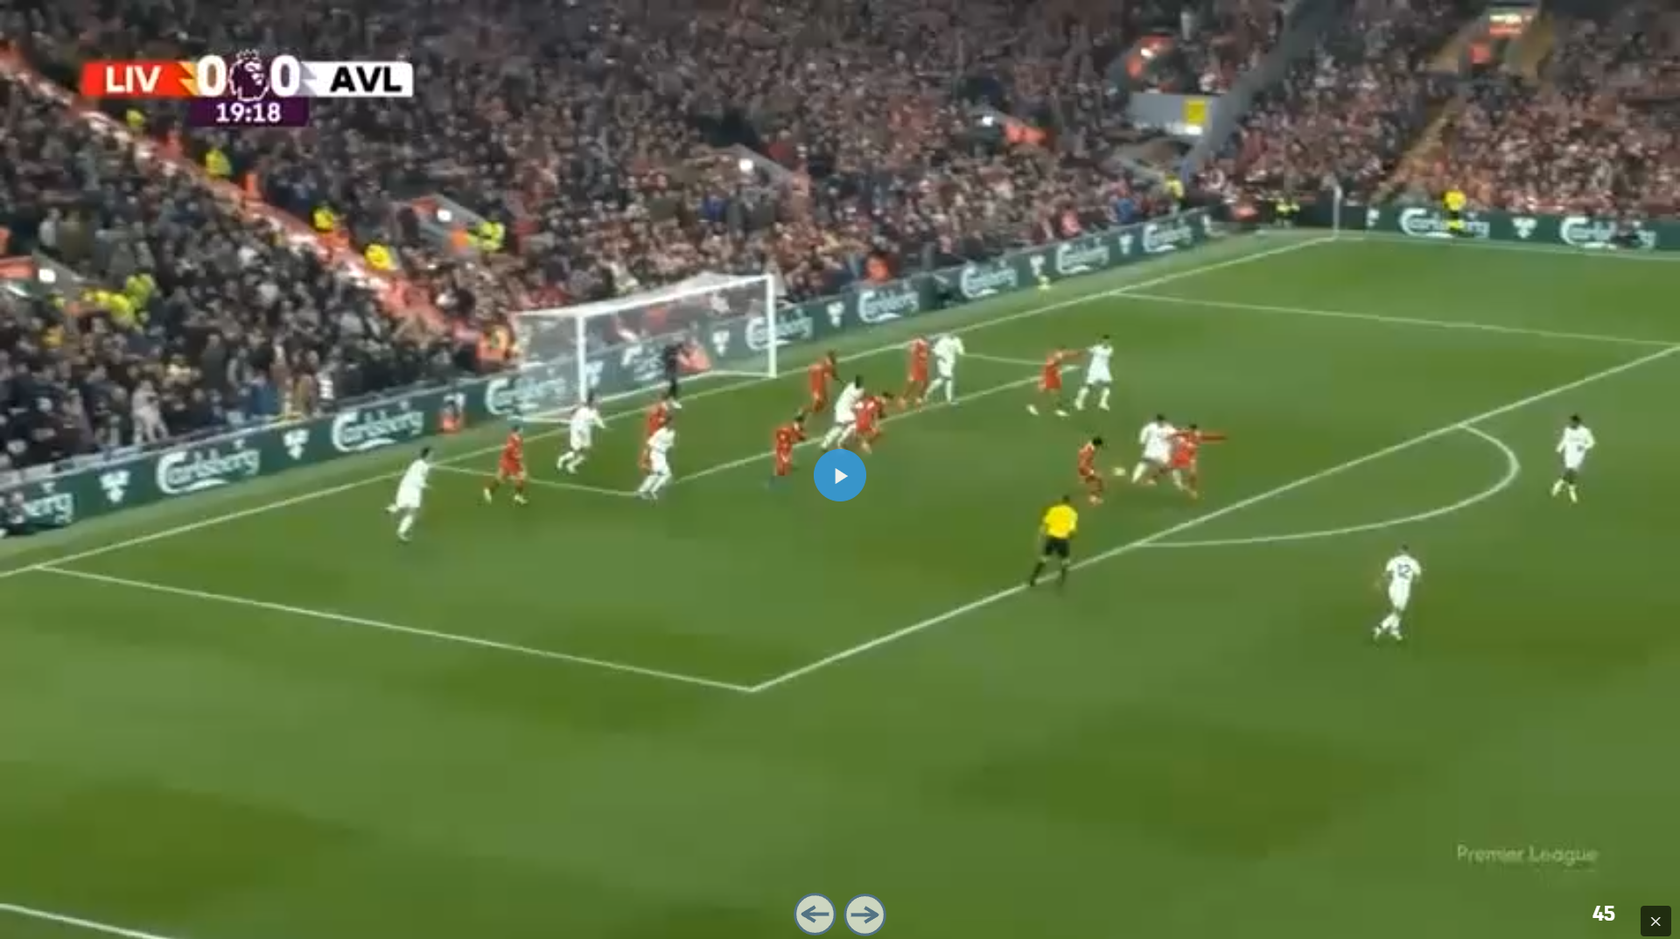
Law Changes

Slide 33
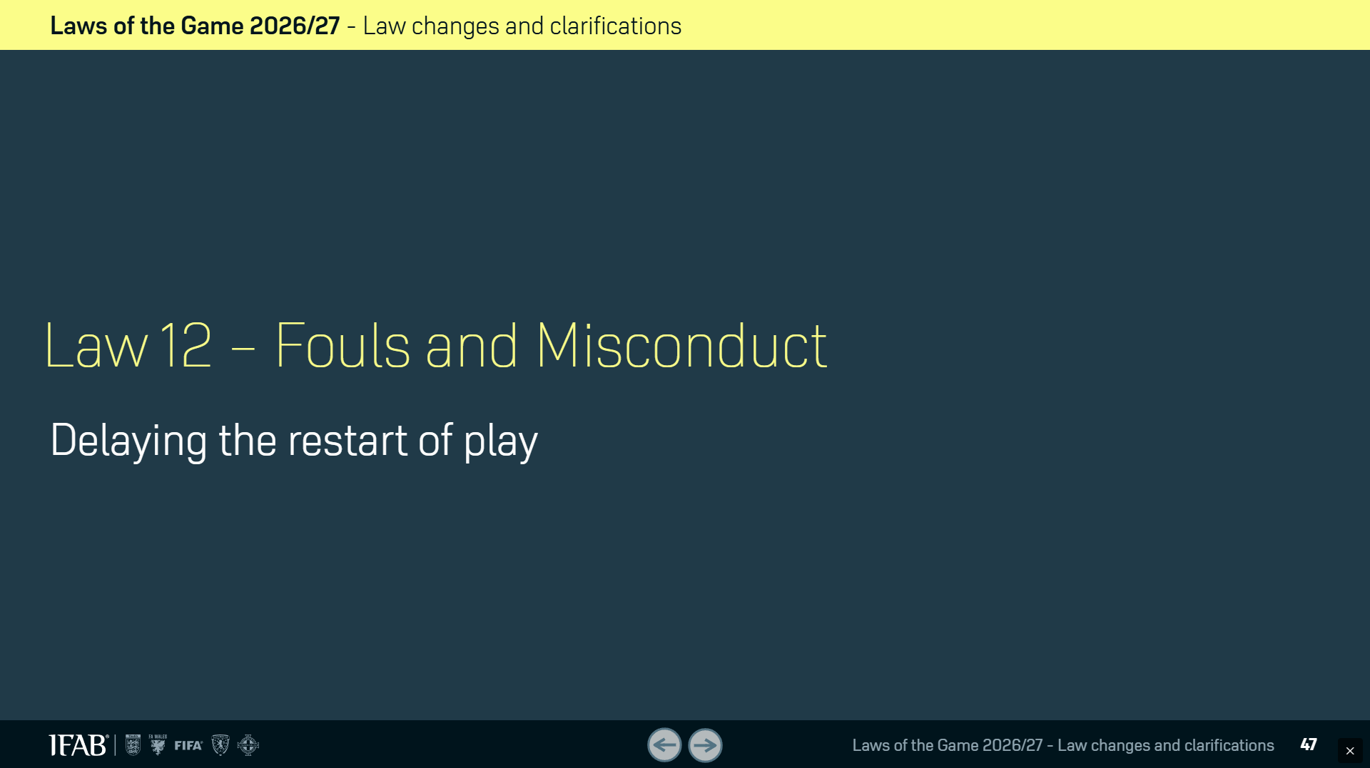
Law Changes

Slide 34
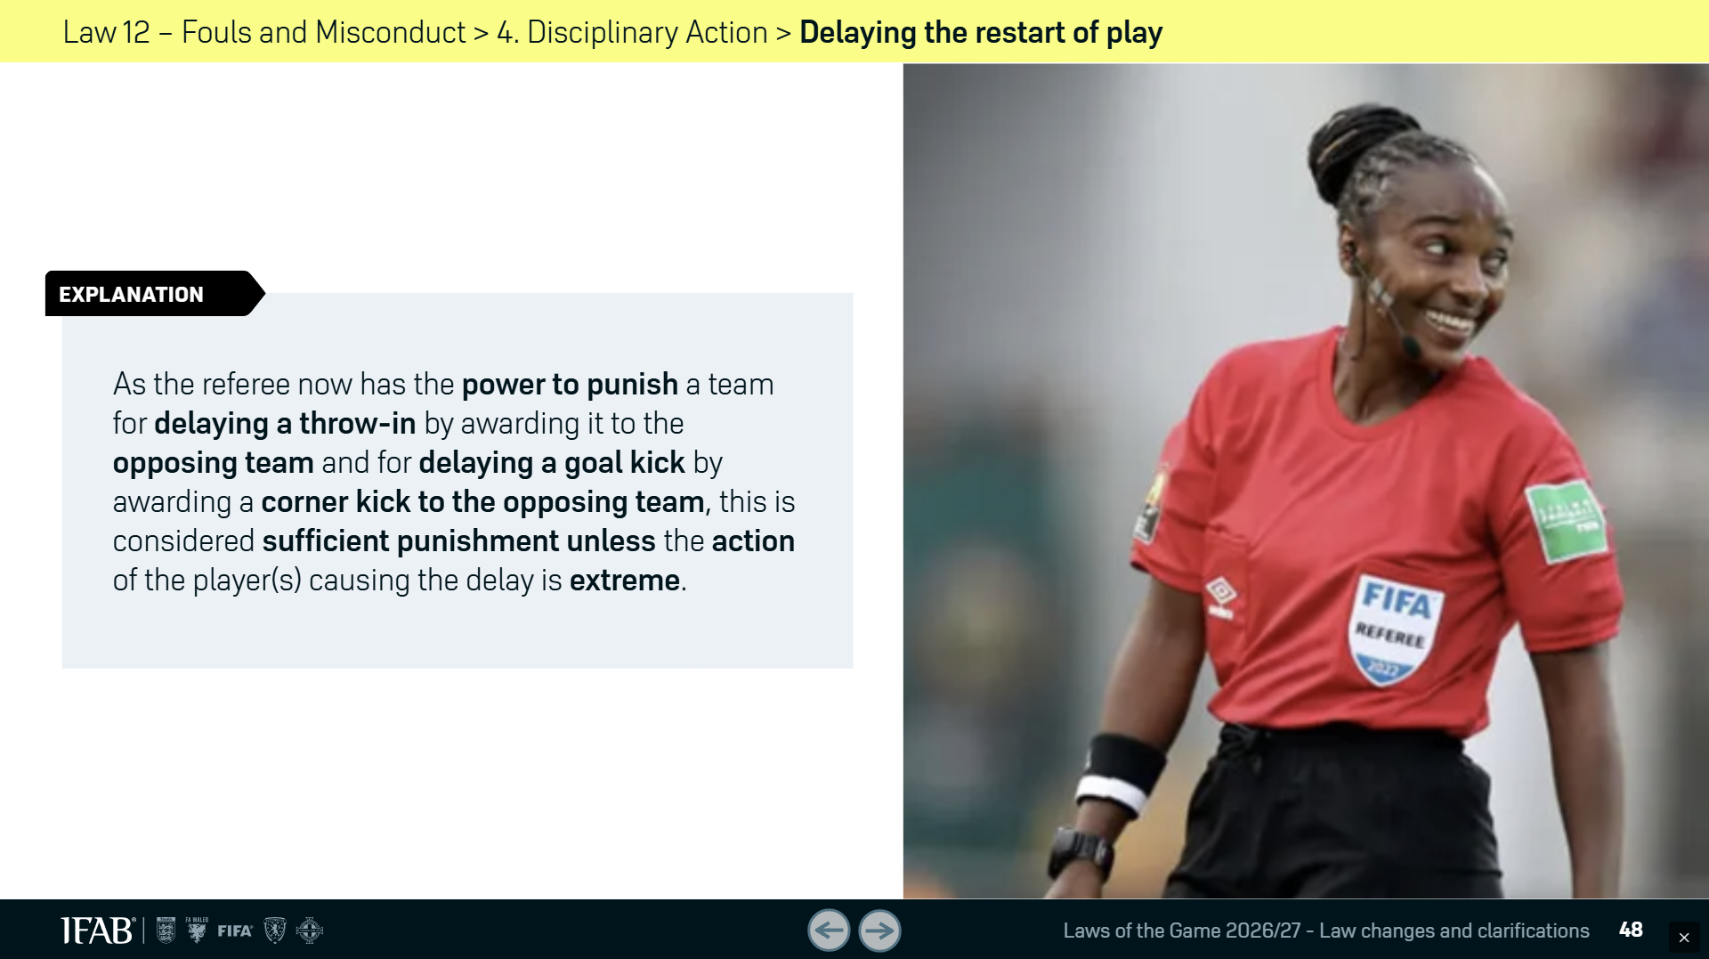
Law Changes

Slide 35
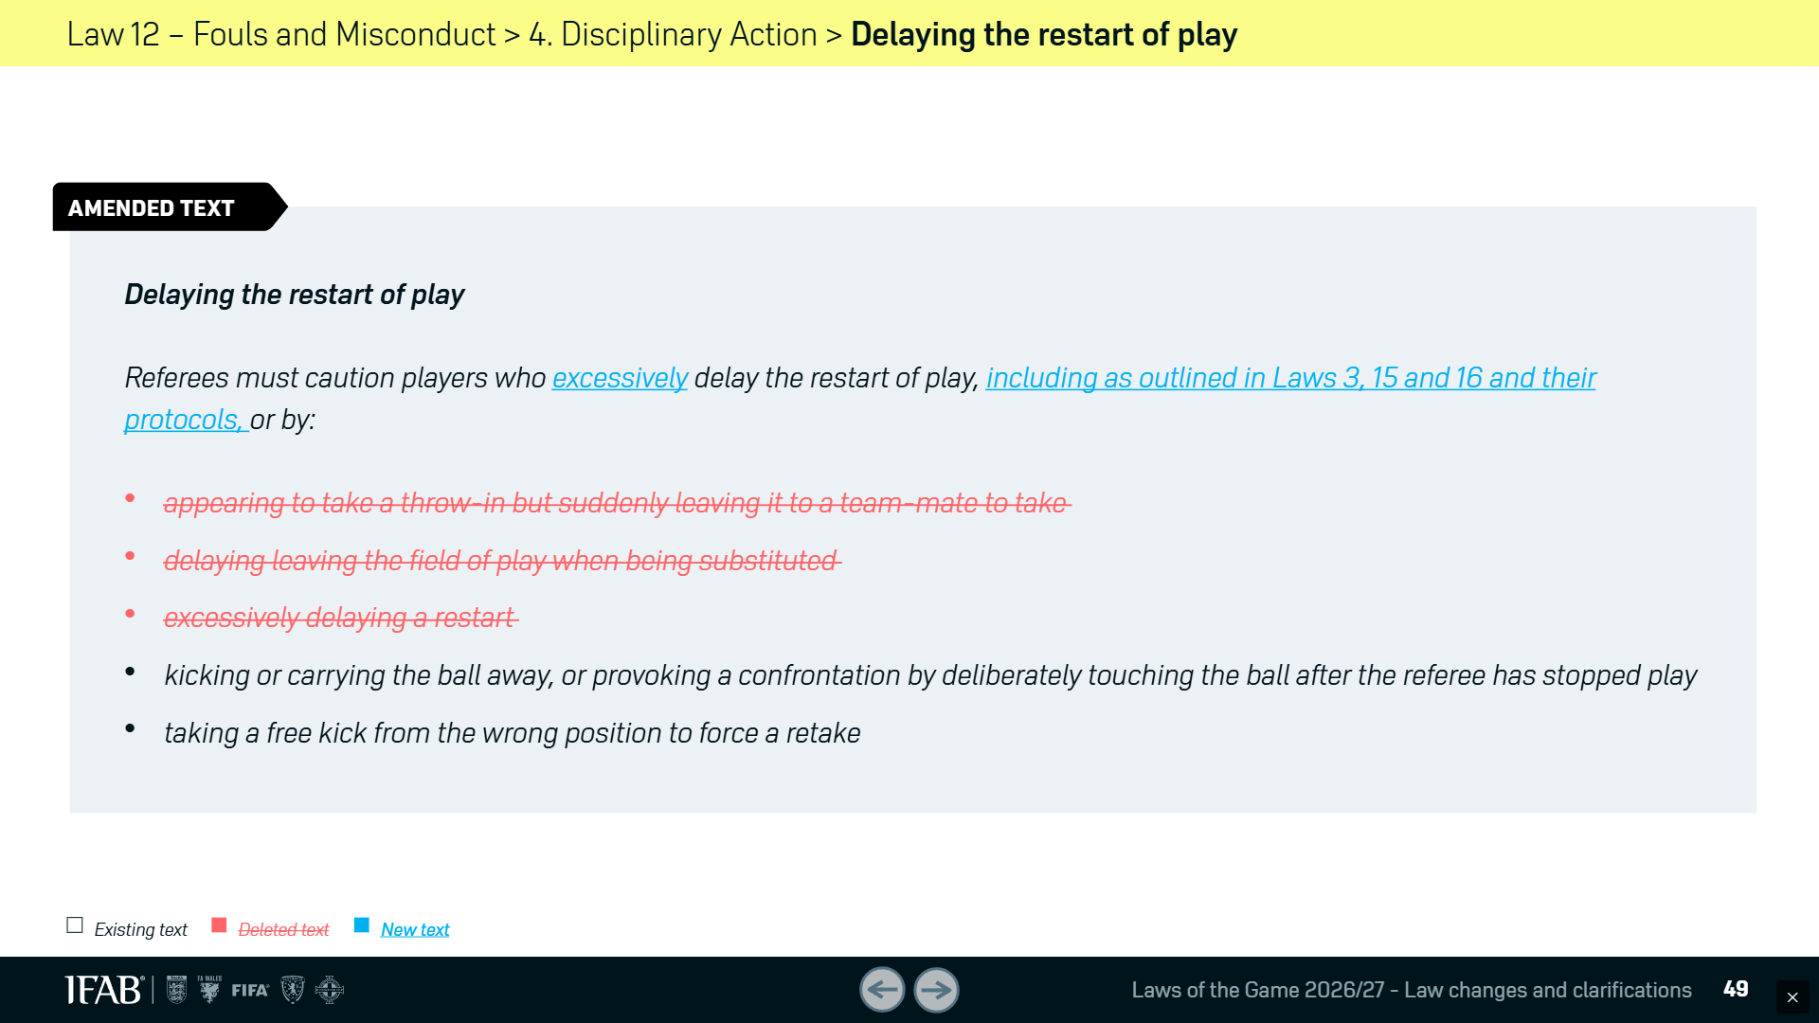
Law Changes

Slide 36
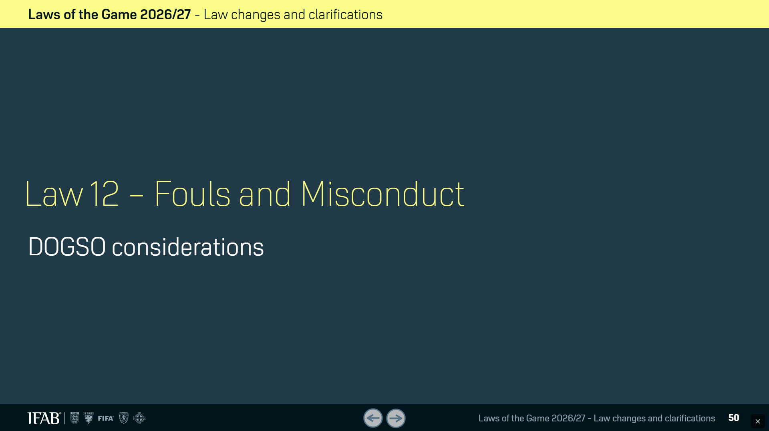
Law Changes

Slide 37
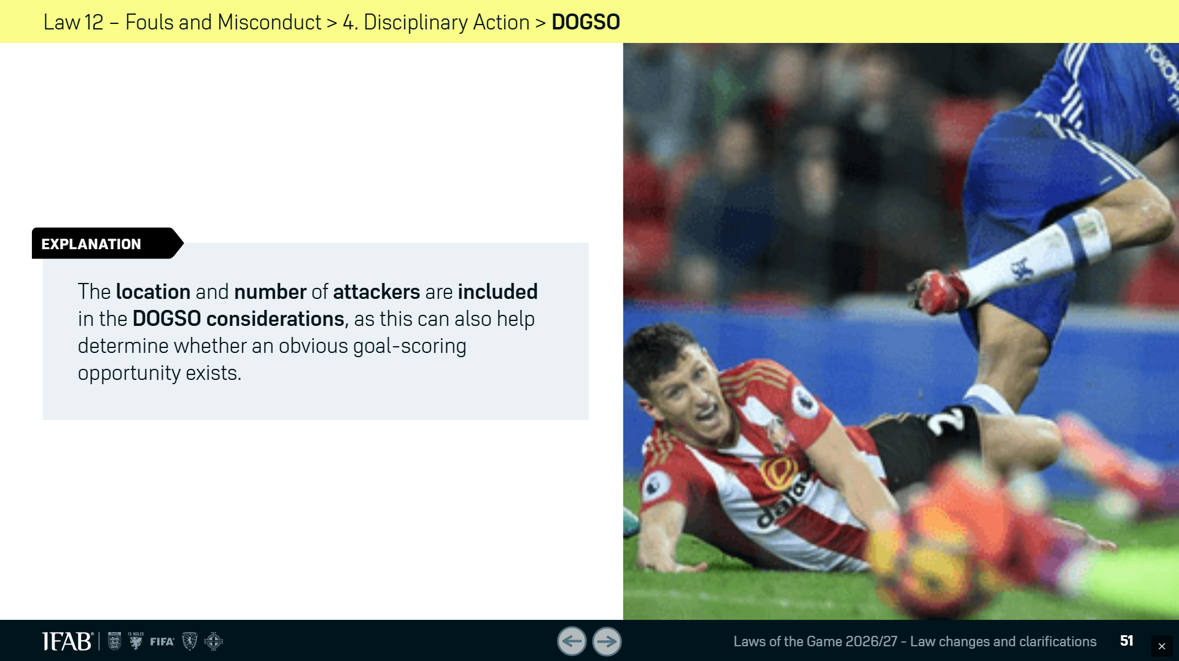
Law Changes

Slide 38
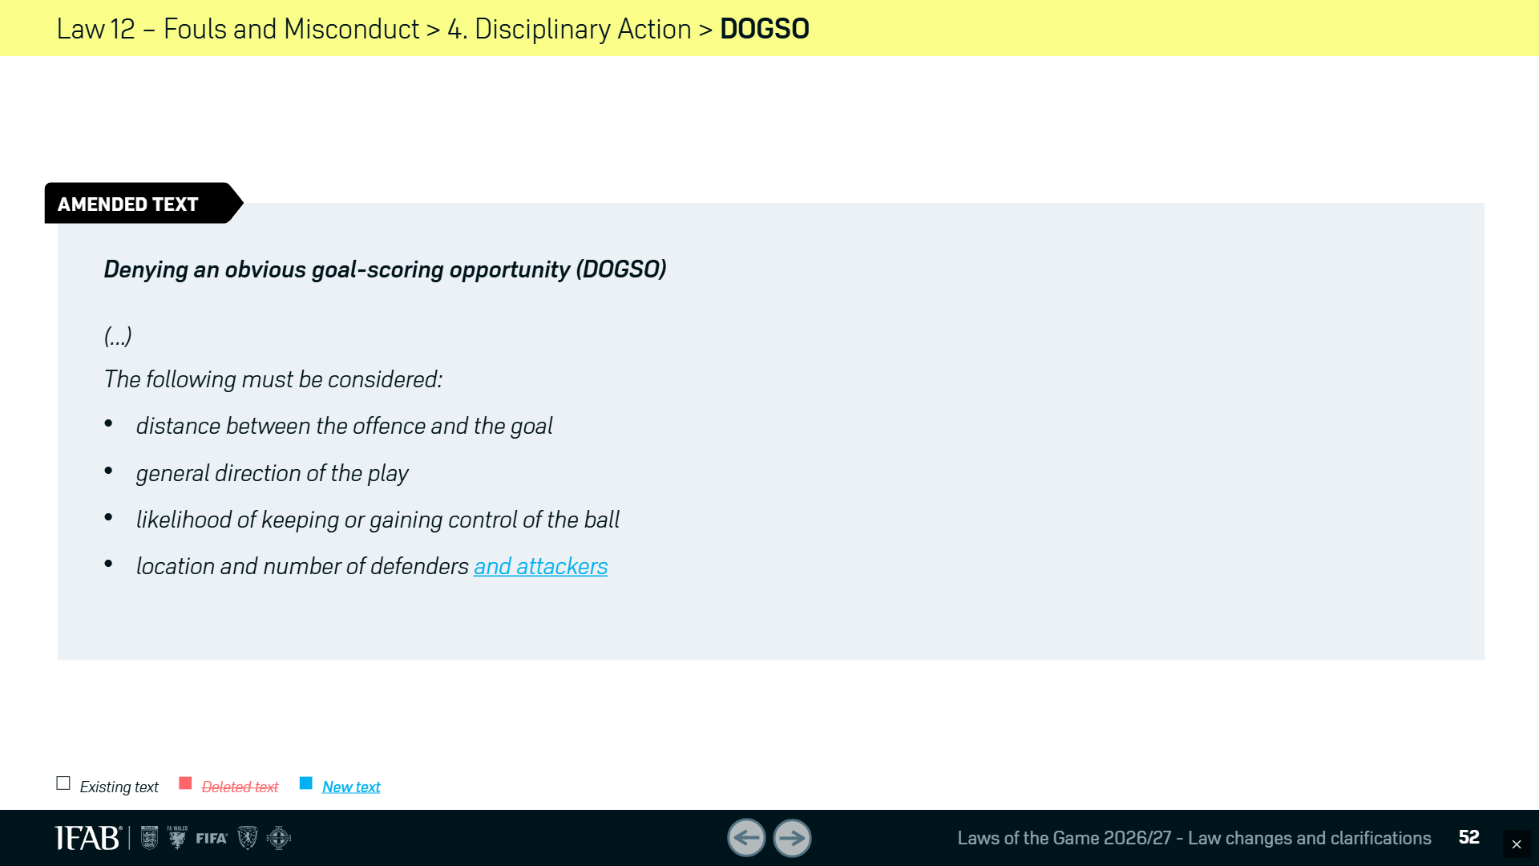
Law Changes

Slide 39
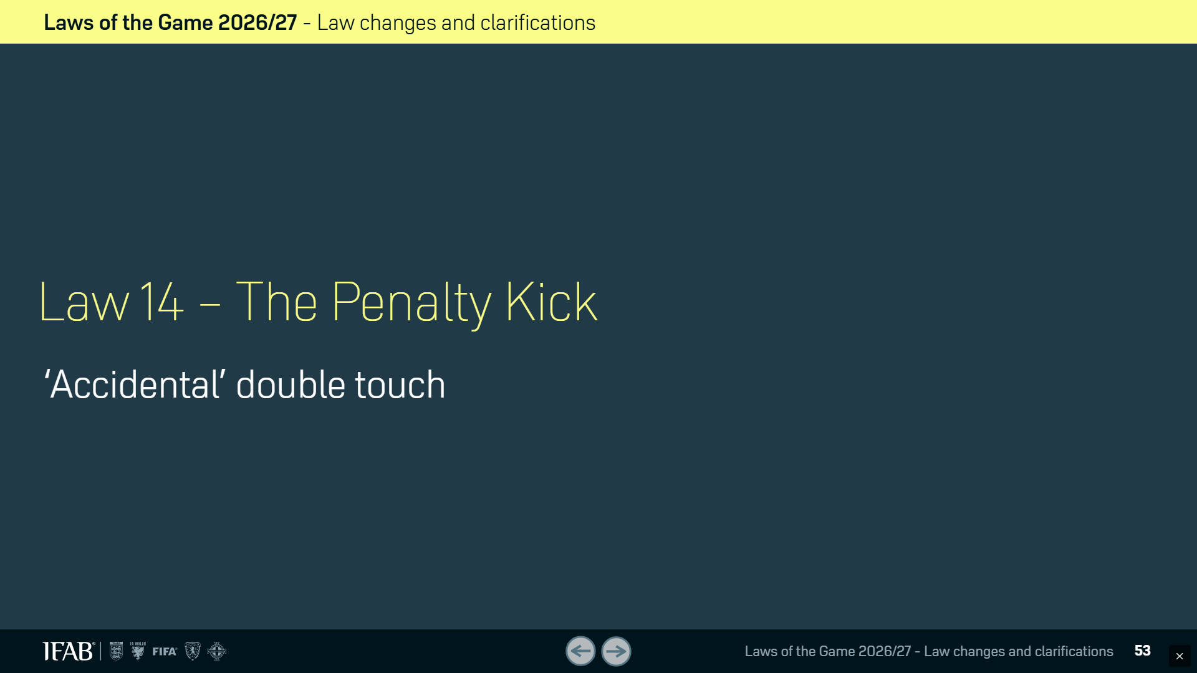
Law Changes

Slide 40
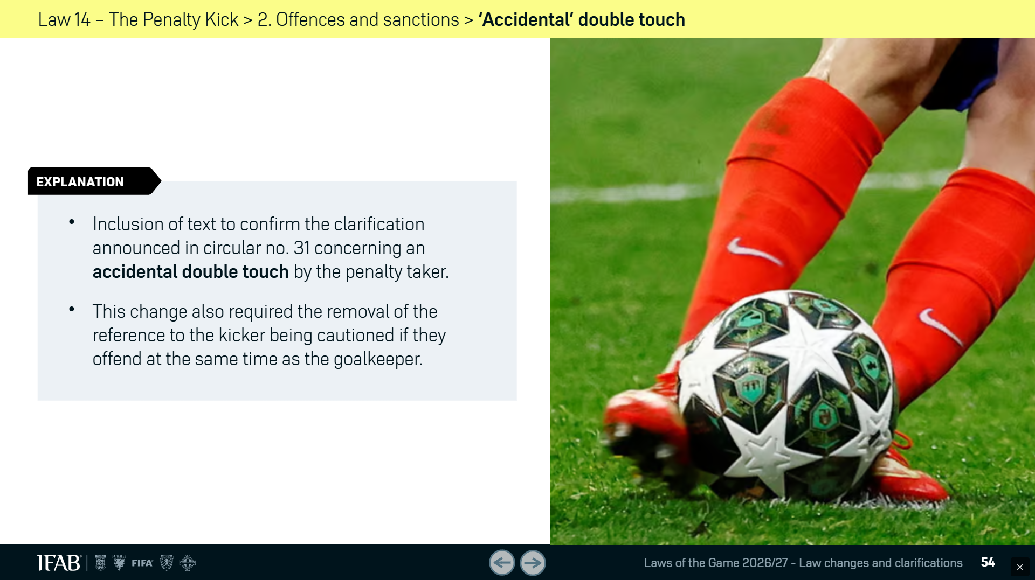
Law Changes

Slide 41
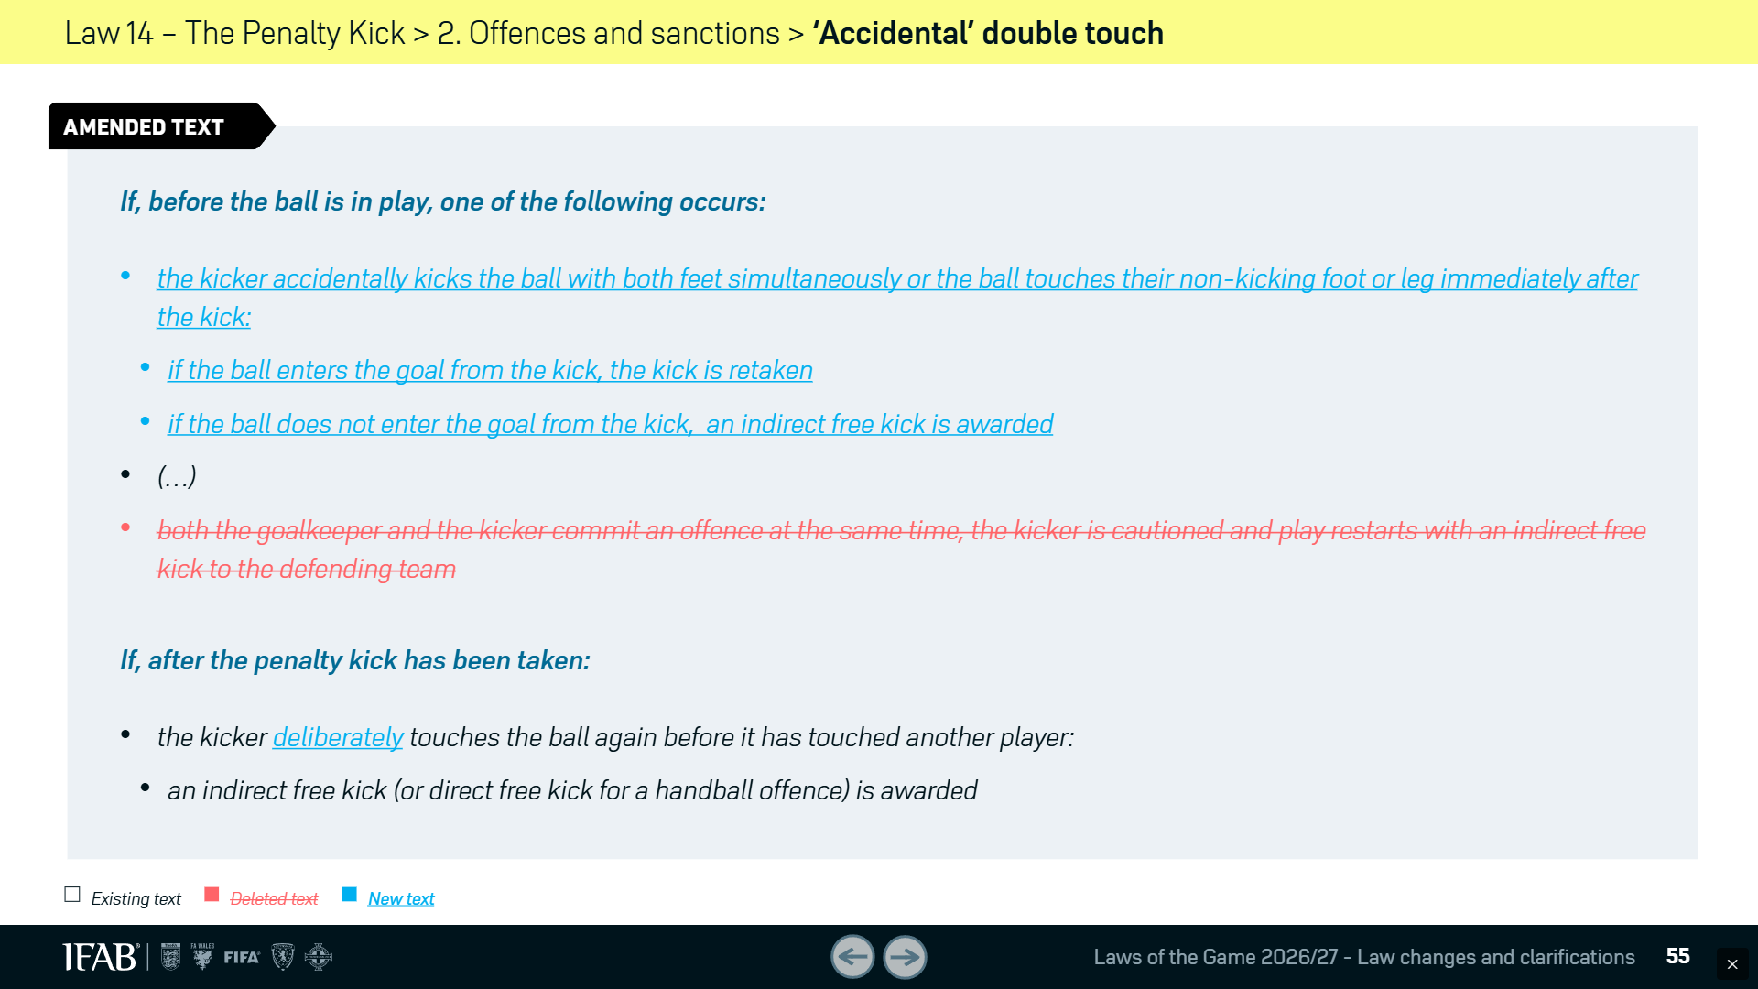
Law Changes

Slide 42
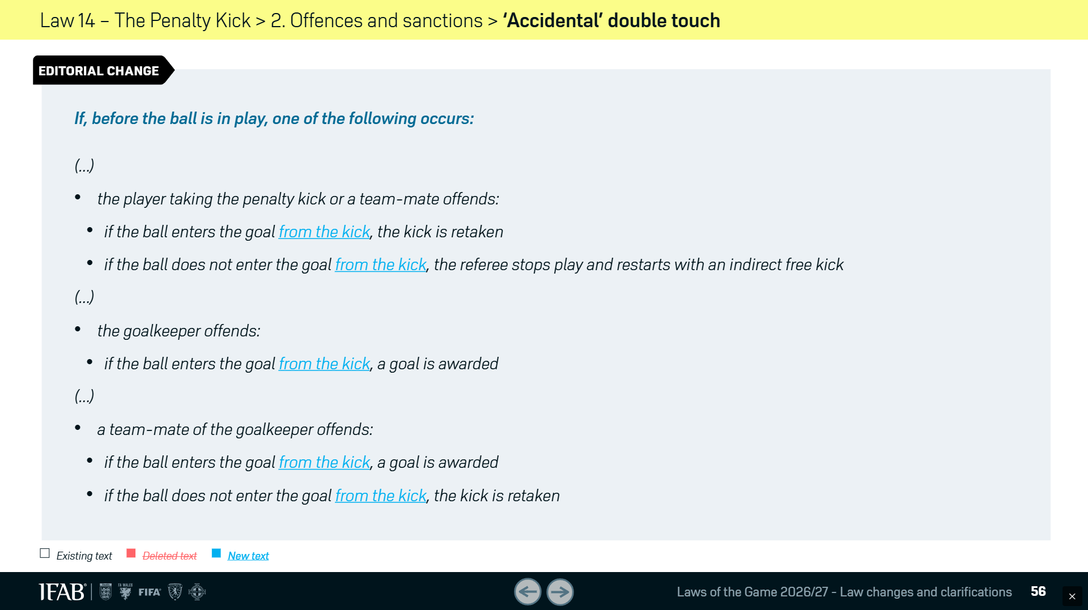
Law Changes

Slide 43
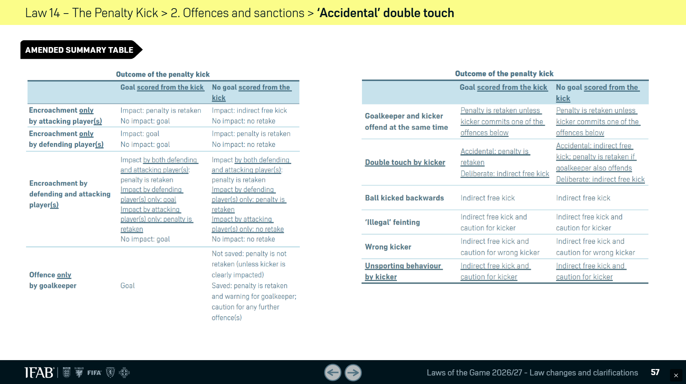
Law Changes

Slide 44
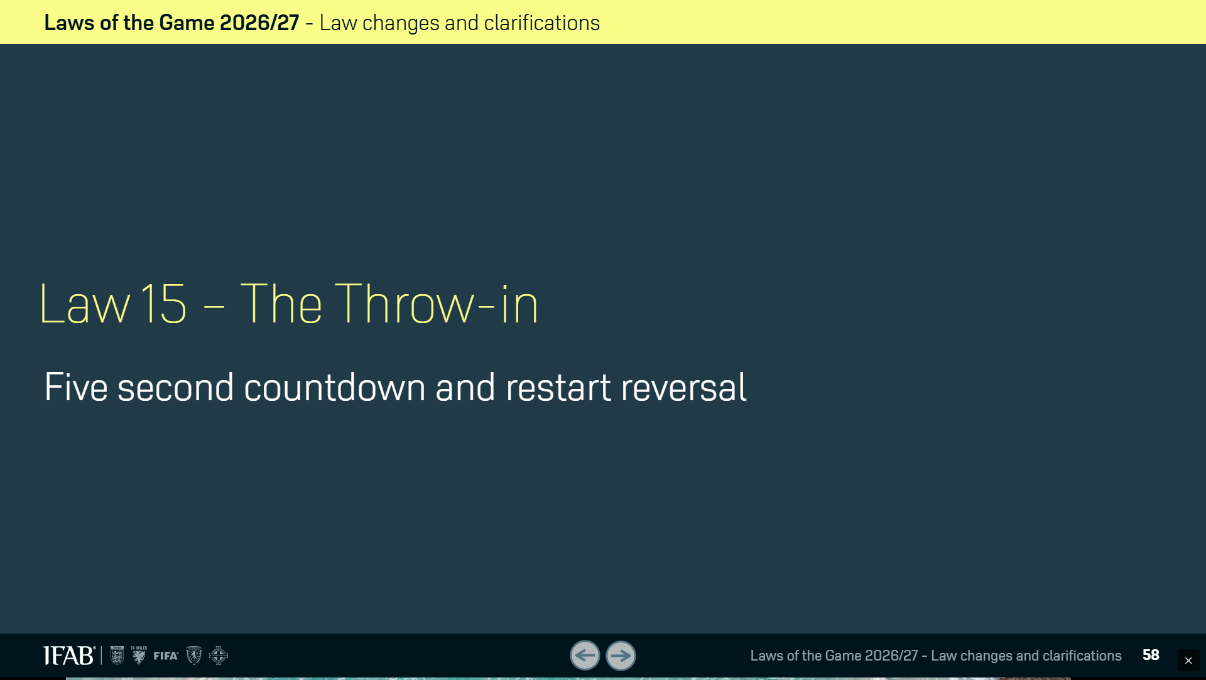
Law Changes

Slide 45
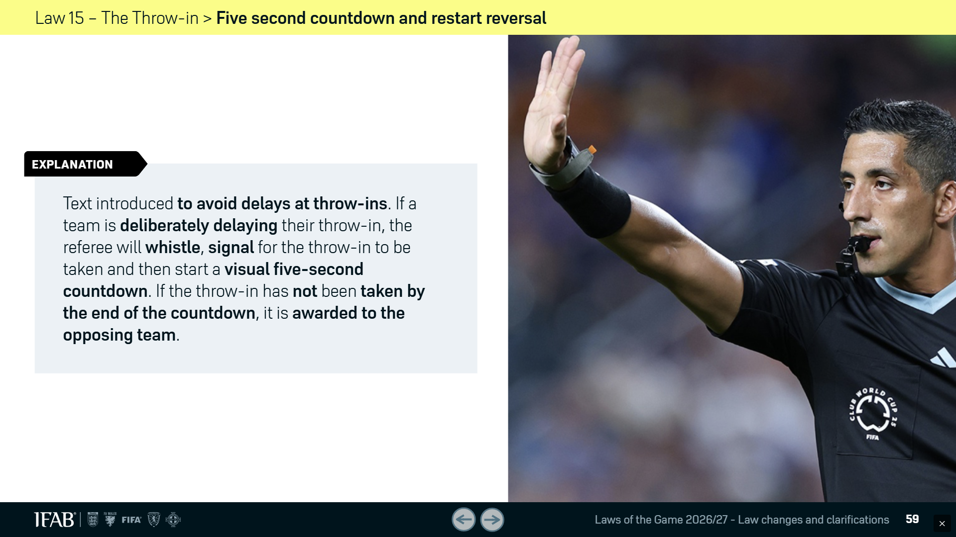
Law Changes

Slide 46
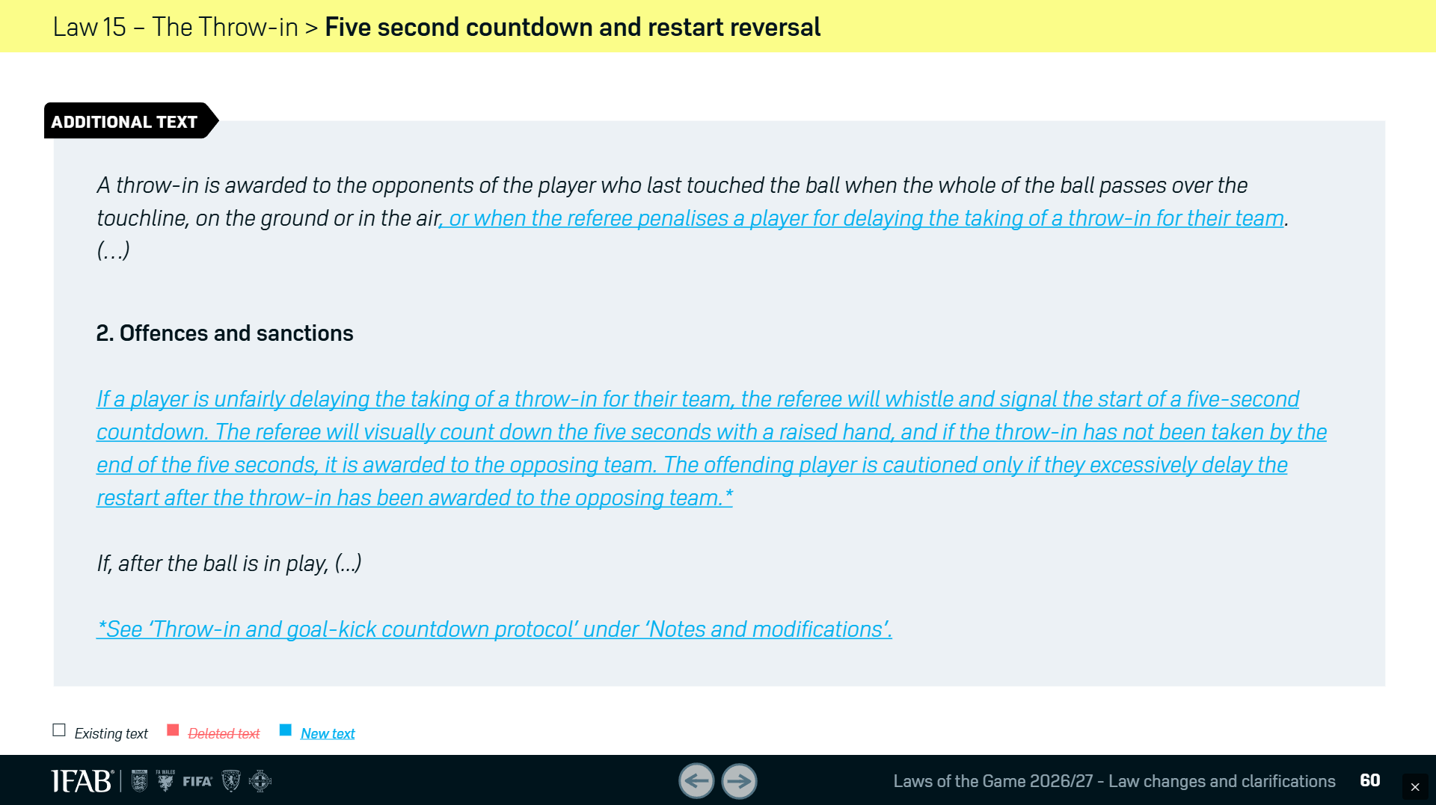
Law Changes

Slide 47
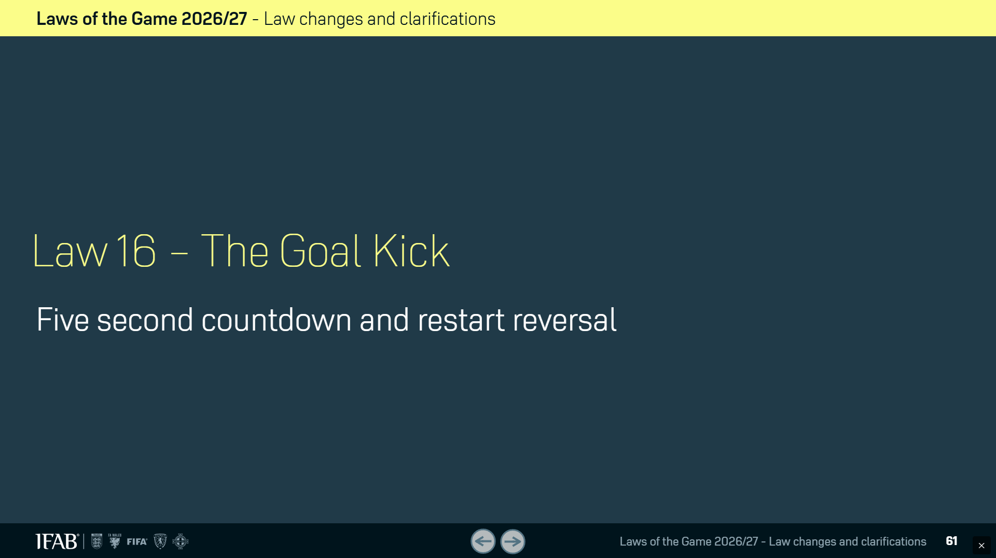
Law Changes

Slide 48
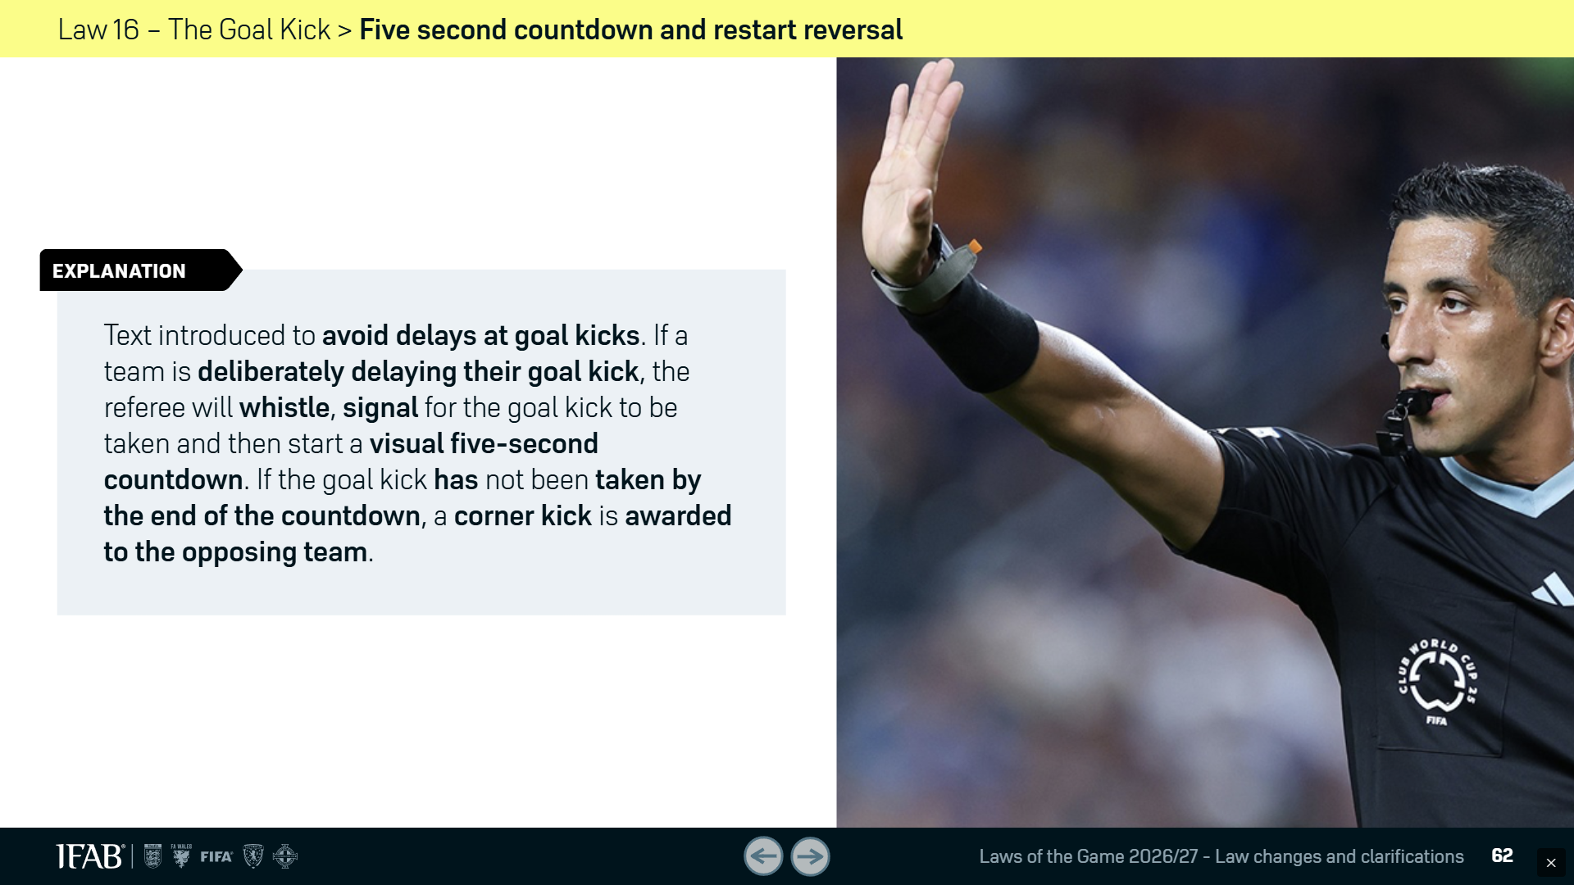
Law Changes

Slide 49

Law Changes

Slide 50


Law Changes

Slide 51

Law Changes

Slide 52

Law Changes

Slide 53

Hand Signal
The referee… will visually countdown the last five seconds with a raised hand.

Slide 54

WSRO Pre-Season Meeting
First Impression

Slide 55


WSRO Pre-Season Meeting
First Impression

Slide 56



WSRO Pre-Season Meeting
First Impression

Slide 57


WSRO Pre-Season Meeting
First Impression

Slide 58


WSRO Pre-Season Meeting
First Impression

Slide 59


WSRO Pre-Season Meeting
First Impression

Slide 60
WSRO Pre-Season Meeting
IFAB Laws of The Game
The IFAB web site is a great resource for referees.
www.theifab.com
Get your phone out, go there and bookmark the page

Slide 61
WSRO Pre-Season Meeting
WSROREF.com Website
LAWS OF THE GAME 26-2027 (English)
Changes to the LOTG 26-2027 (IFAB Full Presentation)
Changes to the LAWS OF THE GAME (26-2027 IFAB Pdf )
Time Limited Substitutions Protocol (2026-27 IFAB PDF)
Throw-In and Goal Kick Countdown Protocol (2026-27 IFAB PDF)
Off-Field Treatment and Assessment Protocol (2026-27 IFAB PDF)
IFAB Documents and Circulars
GoalKeeper controlling the ball with their Hands (2025-26 IFAB Protocol)
Circular 31 – Double touch on Penalty kick
Only the Captain Guidelines
Permanent Concussion Substitutes Protocol

Slide 62
WSRO Pre-Season Meeting
Issues brought up by the leagues:
  A/R priorities and positioning
  Late Hits
  Match Critical Incidents
  First Impressions

Slide 63
WSRO Pre-season Meeting
Questions?
Issues?
Problems?

Slide 64
WSRO Pre-season Meeting
  THANK YOU,
  THE END

